Slide 1
Beyond Coursework in Graduate Programs
Trevor Holmes
Veronica Brown

Slide 2
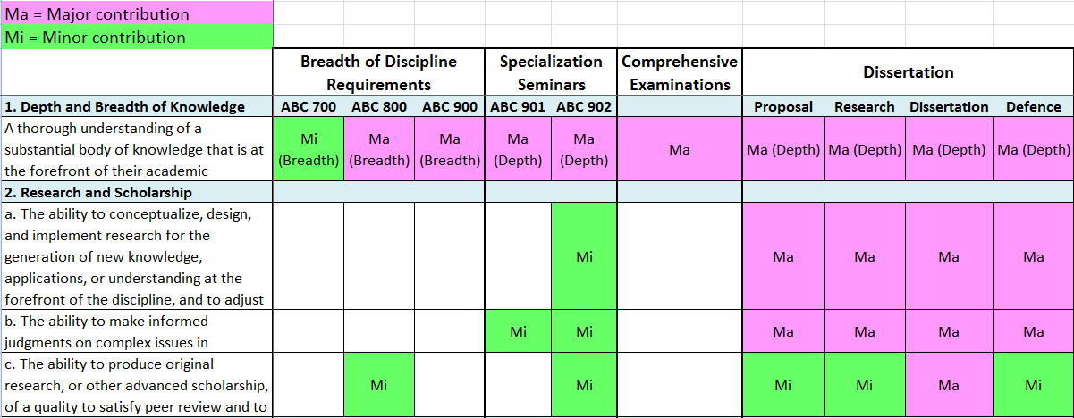
PhD Curriculum Map

Slide 3
Developing Outcomes
Differences between Master and PhD or among Master’s degrees
Brainstorm leads to rich conversation and debate
e.g., PhD - international networks, teaching experience, scholar, researcher
  Where do they get this experience?
  What is the department’s role in developing these attributes?
  If critical, are they captured in the learning outcomes?

Slide 4
Other Key Learning Experiences
Teaching assistant
Research assistant
Professionalization
Role of language requirement
Non-course requirements
  e.g., teaching, safety, academic integrity
External experiences
  e.g., conference participation

Slide 5
Role of Supervision
What is happening during supervisory moments?
Supervision practices
Relationship to program outcomes
Consider adding column to curriculum map

