Slide 1
Introductory Plenary Session
What’s Working in the Learning Outcomes Toolbox?
Symposium on Learning Outcomes
A Toolkit for Assessment
October 16-17, 2014
Eaton Chelsea Hotel
Toronto, Ontario
Eileen DeCourcy
Leesa Wheelahan
Paul Stenton
Peter Wolf
Cindy Hazell
Ross Finnie

Slide 2
Learning Outcomes
Eileen DeCourcy
October 16, 2014
Notes:
Title Slide

Slide 3
Refining, Implementing and Assessing Learning Outcomes in Curriculum
Systematic Approach to Achieving
Constructive Alignment
1. Curriculum Design/Development/Renewal Process
2. Faculty Training and Development on LO
3. Infrastructure/Physical Space

Slide 4
Curriculum Development & Renewal
Ontario Degree Qualifications Framework
Program Renewal
Instructional Design Software (COSSID)
Online course design and review process

Slide 5
Faculty Training & Development
Beliefs/intentions/actions do not always align
Course design as an enactment of beliefs on teaching and learning
Underlying beliefs of teachers (Teaching Perspectives Inventory)

Slide 6
Infrastructure & Physical Space

Slide 7
LO Assessment Tool Kit
Linkage matrix in curriculum mapping
(Technology)
Benchmarking Teaching/Learning/Assessment strategies
Student performance (Relevant learning and authentic assessment – portfolios etc.)

Slide 8
Introductory Plenary Session
What’s Working in the Learning Outcomes Toolbox?
Symposium on Learning Outcomes
A Toolkit for Assessment
October 16-17, 2014
Eaton Chelsea Hotel
Toronto, Ontario
Eileen DeCourcy
Leesa Wheelahan
Paul Stenton
Peter Wolf
Cindy Hazell
Ross Finnie

Slide 9
Introductory Plenary Session
What’s Working in the Learning Outcomes Toolbox?
Symposium on Learning Outcomes
A Toolkit for Assessment
October 16-17, 2014
Eaton Chelsea Hotel
Toronto, Ontario
Eileen DeCourcy
Leesa Wheelahan
Paul Stenton
Peter Wolf
Cindy Hazell
Ross Finnie

Slide 10

2014 Learning Outcomes Conference
Considerations for an Outcomes-Based Culture
Peter Wolf
Peter.Wolf@queensu.ca
Notes:
To use onscreen ONLY

Slide 11
Considerations for an Outcomes-Based Culture
Institutional & Program Outcomes
Program Assessment Processes
Curriculum Development & Assessment
Student Engagement
Institutional Tools & Systems
Internal Alignment
Faculty-Driven
Discipline-Based
Collaborative
Evidence-Based
Learning-Centered
Facilitated
Best Practices
Peter.Wolf@queensu.ca
Notes:
To use onscreen ONLY

Slide 12
Considerations for an Outcomes-Based Culture
  Definitions
  Rubrics
  Communication
  Engagement
Program Assessment Processes
  Multiple stakeholders
  Assessment Plan
  QA alignment
  Continuous improvement
Institutional & Program Outcomes
Curriculum Development & Assessment
Student Engagement
  E-portfolios, capstone experiences, etc.
  Integrate co-, extra- and non-curricular
  Outcomes-based course selection/validation option
Institutional Tools & Systems
  Align accreditation/review/QA
  Connect relevant systems
  Learning analytics
  Collection, assessment, reporting systems
  Policies & practices
  Recognition - DOE, P&T, awards
  Educational development
  Integrated systems
Internal Alignment
Faculty-Driven
Discipline-Based
Collaborative
Evidence-Based
Learning-Centered
Facilitated
Best Practices
Peter.Wolf@queensu.ca
Notes:
To use as Handout

Slide 13
Considerations for an Outcomes-Based Culture
  Definitions
  Rubrics
  Communication
  Engagement
Program Assessment Processes
  Multiple stakeholders
  Assessment Plan
  QA alignment
  Continuous improvement
Institutional & Program Outcomes
Curriculum Development & Assessment
Student Engagement
  E-portfolios, capstone experiences, etc.
  Integrate co-, extra- and non-curricular
  Outcomes-based course selection/validation option
Institutional Tools & Systems
  Align accreditation/review/QA
  Connect relevant systems
  Learning analytics
  Collection, assessment, reporting systems
  Policies & practices
  Recognition - DOE, P&T, awards
  Educational development
  Integrated systems
Internal Alignment
Faculty-Driven
Discipline-Based
Collaborative
Evidence-Based
Learning-Centered
Facilitated
Best Practices
Peter.Wolf@queensu.ca
Notes:
To use as Handout

Slide 14
Introductory Plenary Session
What’s Working in the Learning Outcomes Toolbox?
Symposium on Learning Outcomes
A Toolkit for Assessment
October 16-17, 2014
Eaton Chelsea Hotel
Toronto, Ontario
Eileen DeCourcy
Leesa Wheelahan
Paul Stenton
Peter Wolf
Cindy Hazell
Ross Finnie

Slide 15
Introductory Plenary Session
What’s Working in the Learning Outcomes Toolbox?
Symposium on Learning Outcomes
A Toolkit for Assessment
October 16-17, 2014
Eaton Chelsea Hotel
Toronto, Ontario
Eileen DeCourcy
Leesa Wheelahan
Paul Stenton
Peter Wolf
Cindy Hazell
Ross Finnie

Slide 16
Credit transfer
Leesa Wheelahan
Symposium on Learning Outcomes:
A toolkit for assessment
16 & 17 October, 2014

Slide 17
Trust is most important
Mapping learning outcomes only one element of credit transfer
Zones of mutual trust – what ONCAT represents
Trust at 2 levels – systemic & institutional
Trust an outcome of high levels of social capital
Trust doesn’t develop spontaneously
Notes:
Zones of mutual trust – dependent on consensus, trust & voluntary participation
Trust at 2 levels – systemic & institutional
Most focus is on systemic – this is represented by ONCAT here, but is basis of qualifications frameworks such as in Australia – qualifications automatically accepted
Systemic is a necessary but not sufficient basis for pathways
Systemic trust built by country’s qualifications & quality assurance process & trust that pathways & credit transfer fair & defensible
Can be quickly eroded
International student crisis
Institutional trust - confidence in an institution’s admission standards, syllabus, teaching-learning & assessment
More likely when staff know each other – so not just administrative
Takes time to develop relationships
‘Boundary spanners’ crucial
Build relationships between teachers – college teachers the key because they can heat up or cool out aspirations
Trust an outcome of high levels of social capital
Amey, Eddy & Campbell (2010) Needed to build strong relations, more likely with ‘dense’ relationships
Needs to draw on organisational capital - resources, power, influence, authority, communication systems to drive change
Partnerships become institutionalised when they develop partnership capital – shared norms, shared beliefs and networking that align processes among collaborators
Amey, Eddy and Campbell (2010: 343) note that “partnership work is often hidden, considered ‘extra,’ seen as a service obligation of being a good citizen, and does not always fit into typical work evaluation” & workload allocation.
Trust doesn’t develop spontaneously – needs explicit institutional strategies

Slide 18
Institutional principles
Prioritise & plan no. of pathways
Don’t have pathways for every program
Range from most to least expensive
Given expense, develop pathways to achieve strategic goals
Nested awards are better for social inclusion than dual-awards
Notes:
Prioritise & plan no. of pathways & new programs
Don’t have pathways for every program
No point, if students don’t use them – focus on where traffic is greatest, the pathways students use
Develop individualised or customised pathways for the rest, but increasing traffic is a signal that a pathway is needed
Range from least to most expensive
Alternative entry mechanisms – can be cheap but important – ATAR bonus, dual offers
Standardised pathways – bolted on – moderately expensive – need to be renegotiated every time a program changes
Enhanced pathways most expensive – developed together, labour intensive
Given expense – develop pathways to achieve strategic goals
Eg, establish relationship with professional & industry bodies
Fill an emerging occupational need
Meet needs of particular disadvantaged group
Undertake where there are champions
Nested awards are better for social inclusion than dual-awards
Dual awards are important, but students have to meet the entry criteria for the highest level award first, but with a nested award they meet the entry criteria for the lowest level qualification, and then hav a guaranteed pathway.

Slide 19
Institutional implications
  Strongly supportive institutional cultures reduce ‘cost’, build trust
Effective governance arrangements needed
Boundary spanner – report to someone senior
Funding & resources
Universities need to provide pathways to at least some high demand pathways
Joint institutional strategies needed
Notes:
Strongly supportive institutional cultures reduce ‘cost’, build trust
Effective governance arrangements needed
Strategies, goals & objectives, accountabilities – so not the inclinations of the provost & college director
Boundary spanner – report to very senior person
Have the authority to stare down deans
Funding & resources
Should be a line item in budget, not discretionary
Universities need to provide pathways to at least some high demand pathways
Not use them just to fill load
Joint institutional strategies needed
Joint projects, research & areas of high occupational & social purposes

Slide 20
Further reading
The Australian National Centre for Vocational Education Research (NCVER) publications are free
You will need to register, but that’s all
This is a link to all their publications on pathways
http://goo.gl/dCvXDf

Slide 21
Introductory Plenary Session
What’s Working in the Learning Outcomes Toolbox?
Symposium on Learning Outcomes
A Toolkit for Assessment
October 16-17, 2014
Eaton Chelsea Hotel
Toronto, Ontario
Eileen DeCourcy
Leesa Wheelahan
Paul Stenton
Peter Wolf
Cindy Hazell
Ross Finnie

Slide 22
Introductory Plenary Session
What’s Working in the Learning Outcomes Toolbox?
Symposium on Learning Outcomes
A Toolkit for Assessment
October 16-17, 2014
Eaton Chelsea Hotel
Toronto, Ontario
Eileen DeCourcy
Leesa Wheelahan
Paul Stenton
Peter Wolf
Cindy Hazell
Ross Finnie

Slide 23
What’s working in the Learning Outcomes Toolbox?
Learning Outcomes, Credit Transfer & Mobility

Slide 24
Learning Outcomes, Credit Transfer & Mobility
Practitioner’s perspective
Facilitating, not guaranteeing, CT
Reconciling tension between institutional/faculty variations, local responsiveness vs. mobility and transfer
Within and Between Institutions, Faculties, Campuses, Modes of Delivery

Slide 25
Learning Outcomes, Credit Transfer & Mobility
Some Promising Practices
C to C Transfer - Program, Subject Outcomes (e.g. CCVPA Transfer Protocol)
C to C Transfer - “Mid-stream exit” Outcomes (CCVPA project, 2012)
New Program Development –Defining diploma vs. degree level curriculum; Bridging Programs (PEQAB “Degree Standard”)
Diploma to Degree Pathways (C-C; C-U) - Gap Analysis and Bridging (www.peqab.ca)
Designing Dynamic Bilaterals (new partners, new pathways, changing curriculum) - using Curriculum Mapping (ONCAT project calls)

Slide 26
Learning Outcomes, Credit Transfer & Mobility
Some Challenges
Different cultures, academic traditions; speaking the same language?
Trust & credibility (“guardians of quality”)
Liberal arts, electives - maximizing choice and breadth vs. transferability (HEQCO Tuning ++)
Accrediting bodies – content, resource-dependent, time-based
…..But LO’s offer opportunities to mitigate these!

Slide 27
Introductory Plenary Session
What’s Working in the Learning Outcomes Toolbox?
Symposium on Learning Outcomes
A Toolkit for Assessment
October 16-17, 2014
Eaton Chelsea Hotel
Toronto, Ontario
Eileen DeCourcy
Leesa Wheelahan
Paul Stenton
Peter Wolf
Cindy Hazell
Ross Finnie

Slide 28
Introductory Plenary Session
What’s Working in the Learning Outcomes Toolbox?
Symposium on Learning Outcomes
A Toolkit for Assessment
October 16-17, 2014
Eaton Chelsea Hotel
Toronto, Ontario
Eileen DeCourcy
Leesa Wheelahan
Paul Stenton
Peter Wolf
Cindy Hazell
Ross Finnie

Slide 29


What’s Working in the Learning Outcomes Toolbox?: Employability/Student Success
A New Tool:
2014 Learning Outcomes Symposium  October 16, 2014
Paul Stenton, Deputy Provost and Vice Provost, University Planning

Slide 30
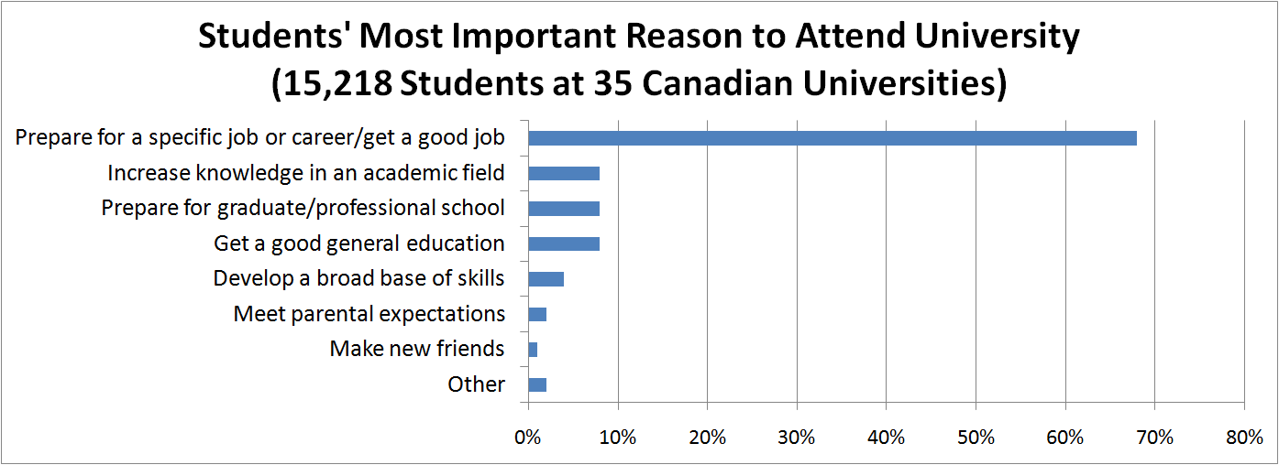
Employability is a Priority
Government:
“… ensure that students graduate with skills that respond to local and provincial labour market needs and contribute to social development.”
(Ontario’s Differentiation Policy Framework for Postsecondary Education)
Students:
30
(Canadian University Survey Consortium, First-Year Student Survey 2013)

Slide 31
Current Employment Outcomes Data
high-level,
Episodic,
delayed:
Periodic program reviews
Ontario University Graduate Survey (OUGS)
National Baccalaureate Graduate Outcomes Survey
National Graduate Survey (Statistics Canada)
Canadian Occupational Projection System and sectoral labour market studies (ESDC – Employment and Social Development Canada)

Slide 32
Magnet: A Tool for Connecting Students to the Labour Market
Magnet is a network where students and alumni create profiles and connect to employment opportunities that match their skills and interests
Automates short-listing of candidates
Provides real-time supply and demand labour market insight for institutions
  Launched September 2014
  Underlying software incubated by Ryerson’s Digital Media Zone
  Funded by Ministry of Training, Colleges and Universities

Slide 33
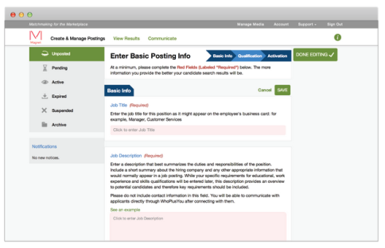

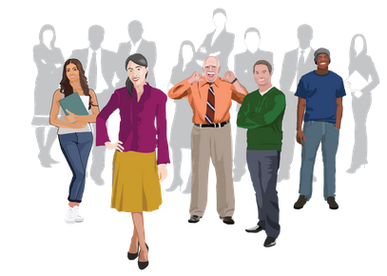
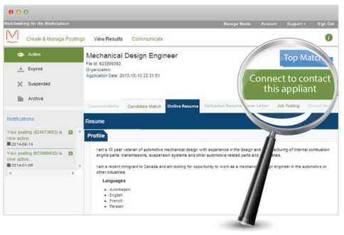
How Does Magnet Work?
Students/Alumni
Magnet
Employers
Students/Alumni create a profile of their education, skills, and employment history.
Employers specify what they’re looking for in their ideal candidate using the same skills taxonomy.
Magnet notifies employers about top matching candidates.
Employers evaluate matches and invite ideal candidates to connect through Magnet.
Students/alumni decide whether to connect with employers through Magnet.

Slide 34
Data Mining: Feedback to Colleges and Universities
Labour force trends: Learn about trends in local labour force needs
Skills/jobs taxonomy: Same taxonomy used by students/alumni and employers
Potential feedback loop: Potential insights into labour market skills in demand
Network to-date: 26,000 students and 1,300 employers have participated
Rapidly growing network and mineable database
www.magnet.today

Slide 35
Introductory Plenary Session
What’s Working in the Learning Outcomes Toolbox?
Symposium on Learning Outcomes
A Toolkit for Assessment
October 16-17, 2014
Eaton Chelsea Hotel
Toronto, Ontario
Eileen DeCourcy
Leesa Wheelahan
Paul Stenton
Peter Wolf
Cindy Hazell
Ross Finnie

Slide 36
Introductory Plenary Session
What’s Working in the Learning Outcomes Toolbox?
Symposium on Learning Outcomes
A Toolkit for Assessment
October 16-17, 2014
Eaton Chelsea Hotel
Toronto, Ontario
Eileen DeCourcy
Leesa Wheelahan
Paul Stenton
Peter Wolf
Cindy Hazell
Ross Finnie

Slide 37

Post-Schooling Outcomes of University Graduates:
A Tax Data Linkage Approach
Ross Finnie (rfinnie@uottawa.ca)

Slide 38
1998 Cohort –
Social Science Graduates
Notes:
The first cohort available in our dataset – and has the longest series of tax data available.
Refers to GRADUATION cohort.
They graduated before the tech bubble.

Slide 39
Mean Earnings of 1998 Cohort ($2011) –
Social Science Graduates
Years After Graduation

Slide 40
Mean Earnings of 1998 Cohort ($2011) –
Social Science Graduates
Years After Graduation

Slide 41
Mean Earnings of 1998 Cohort ($2011) –
Social Science Graduates
Years After Graduation

Slide 42
Mean Earnings of 1998 Cohort ($2011) –
Social Science Graduates
Years After Graduation

Slide 43
Mean Earnings of Selected Cohorts ($2011) –
Social Science Graduates
Years After Graduation

Slide 44
Adding Other Cohorts:
1998 + 2000, 2004, 2008
Notes:
The first cohort available in our dataset – and has the longest series of tax data available.
Refers to GRADUATION cohort.
They graduated before the tech bubble.

Slide 45
Mean Earnings of 1998 Cohort ($2011) –
Social Science Graduates
Years After Graduation

Slide 46
Mean Earnings of Cohorts ($2011)
Years After Graduation

Slide 47
Mean Earnings of Selected Cohorts ($2011) –
Social Science Graduates
Years After Graduation

Slide 48
Comparing Social and
Humanities Graduates
Notes:
The first cohort available in our dataset – and has the longest series of tax data available.
Refers to GRADUATION cohort.
They graduated before the tech bubble.

Slide 49
Mean Earnings of Selected Cohorts ($2011)

Slide 50
The Story: Starting levels vs. increases over time – the importance of a longer-run perspective
Notes:
The first cohort available in our dataset – and has the longest series of tax data available.
Refers to GRADUATION cohort.
They graduated before the tech bubble.

Slide 51
Comparing Graduates
Across All Faculties
Notes:
The first cohort available in our dataset – and has the longest series of tax data available.
Refers to GRADUATION cohort.
They graduated before the tech bubble.

Slide 52
Mean Earnings of Selected Cohorts ($2011)

Slide 53
Mean Earnings of Selected Cohorts ($2011)

Slide 54
Mean Earnings of Selected Cohorts ($2011)

Slide 55
Mean Earnings of Selected Cohorts ($2011)

Slide 56
Mean Earnings of Selected Cohorts ($2011)

Slide 57
Numerous Stories:
- starting levels
- increases over time
- stability vs. variability
A unique new perspective
Notes:
The first cohort available in our dataset – and has the longest series of tax data available.
Refers to GRADUATION cohort.
They graduated before the tech bubble.

Slide 58
Those Near the Top, in the
Middle, at the Bottom
Notes:
The first cohort available in our dataset – and has the longest series of tax data available.
Refers to GRADUATION cohort.
They graduated before the tech bubble.

Slide 59
Quintile Means: 1998 Cohort – No Top Quintile

Slide 60
Post-98?
Notes:
The first cohort available in our dataset – and has the longest series of tax data available.
Refers to GRADUATION cohort.
They graduated before the tech bubble.

Slide 61
2008 Recession: First Year Earnings ($2011)

Slide 62
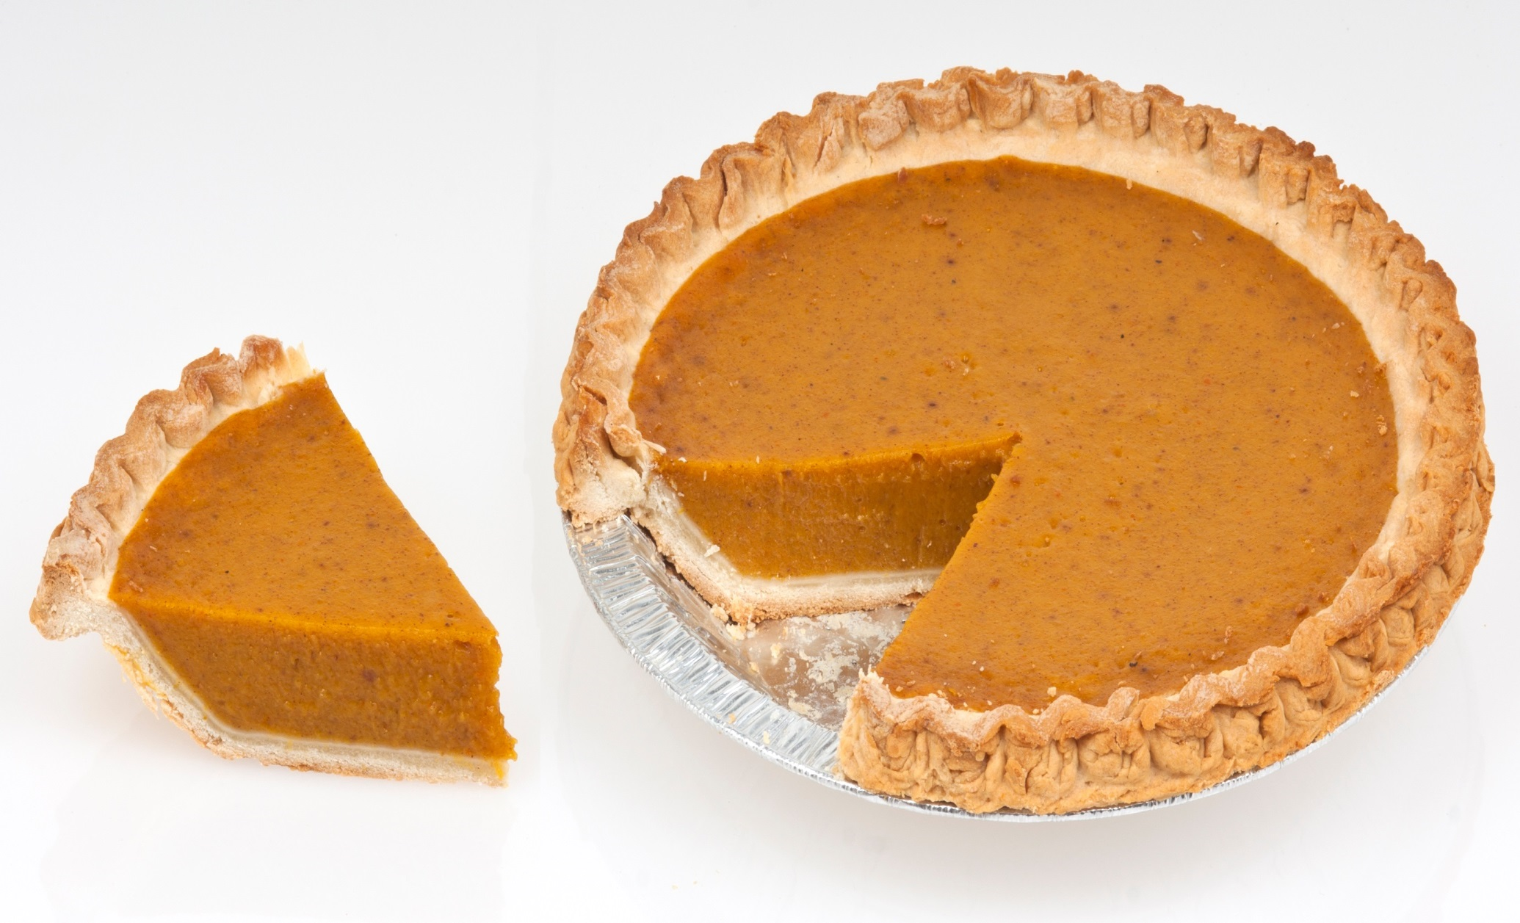
Just a taste…☺
Notes:
The first cohort available in our dataset – and has the longest series of tax data available.
Refers to GRADUATION cohort.
They graduated before the tech bubble.

Slide 63
Post-Schooling Outcomes of University Graduates:
A Tax Data Linkage Approach
Ross Finnie (rfinnie@uottawa.ca)

