Slide 1


Developing Adaptable and Resilient Life Long Learners
Employer Perspectives on Work-Integrated Learning
Val Walker, PhD,
CEO Business + Higher Education Roundtable (www.bher.ca)
Notes:
[Thank Matt and Norah for their presentation]
[Briefly introduce yourself and BHER]
With the context that Matt provided on the different types of WIL and Norah’s framework on quality assurance, I wanted to focus my comments today on 3 things:
Recent WIL data from the National Graduate Survey;
What we’re hearing from employers; and
What we’re doing to help.
But first, an overarching question. It’s often my answer when people ask “what keeps me up at night”?... and I think it’s relevant to our discussion today: <click>

Slide 2

How do we short circuit the way we think about education, work, and the transition between the two?
Educators
Employers
Learners (life-long)
Notes:
We work way longer than we’re in school but think that what we get in school should set us up for our whole career
One way to short circuit this thinking is by starting work while we’re still *in* school.
Learner pathways are no longer linear…
This is a message that is familiar to most of you listening today. (the educators)
Message for employers: They have to short circuit their thinking as well. (i.e. take on people while they’re still learning)... can’t expect fully developed workers on day 1
But what about learners?... well, and this may be hard to hear but part of the problem is that... <click>

Slide 3
Traditional credentials
Skills and competencies
Notes:
Tradition credentials aren’t as helpful as they’ve been in the past
Increasingly, credentials are an insufficient proxy for skills and competencies (hard to hear, maybe… but it’s what employers are telling us (think history + coding...))
BUT obviously we’re not ready for (and it’s probably not a good idea) to go to the other extreme, which is to get rid of them all together.. (but cool, Shopify if you want…)
SO? Solution for both challenges (short circuiting expectations and crappy proxies for skills/competencies)?
WIL!

Slide 4

WIL & labour market outcomes
 | No WIL | With WIL
College
Job related to studies? | 70% | 82%
Satisfied with job? | 83% | 85%
Bachelors
Job related to studies? | 70% | 92%
Satisfied with job? | 76% | 85%
Statistics Canada. Table 37-10-0188-01 National Graduates Survey (NGS), labour market outcomes of postsecondary graduates at time of interview, by province of study, level of study, field of study, sex and work-integrated learning (WIL) participation

Slide 5

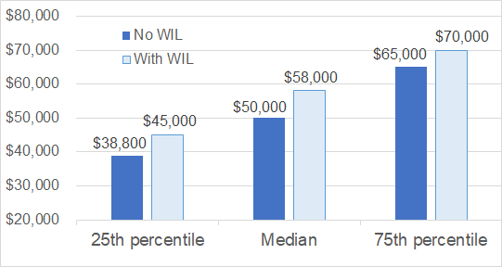
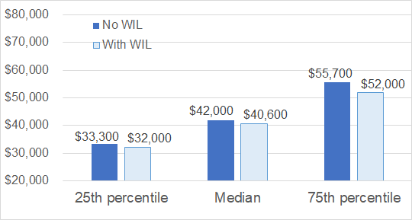
WIL & labour market outcomes
Bachelors - 2015 graduates
College - 2015 graduates
Estimated Gross Annual Earnings
Statistics Canada. Table 37-10-0188-01 National Graduates Survey (NGS), labour market outcomes of postsecondary graduates at time of interview, by province of study, level of study, field of study, sex and work-integrated learning (WIL) participation
Notes:
So where are we now? Data on 2015 post-secondary graduates
50% of all 2015 graduates participated in WIL: 61% of the college graduates, 48% of the bachelor’s graduates
**These data *exclude* graduates who pursued further education between graduation and the time of the interview.
College includes college or other non-university certificates, college or other non-university diplomas, collège d'enseignement général et professionnel (CEGEP) certificates, and CEGEP diplomas.
Bachelor's includes bachelor's degrees (excluding degrees in law, medicine, dentistry, veterinary medicine, optometry, and pharmacy), university certificates below bachelor's degrees, and university diplomas below bachelor's degrees.

Slide 6
What we’re hearing from
employers: why participate in WIL?
Skilled Talent Pipeline: employers gain access to a pool of potential candidates who have relevant skills and who are prepared to fill key roles within their organizations.
Innovation and Knowledge Translation: students contribute ideas and/or innovations to organizations during their work placements.
Diversity & Inclusion: WIL programs and/or students contribute to an organization’s mission, strategies, and practices to support a diverse workplace.
Corporate Social Responsibility: students help to advance an organization’s corporate social responsibility goals.
Notes:
In focus groups organized per sector conducted recently by BHER and the Conference Board of Canada the following key insights have emerged in conversations with employers from different sectors across the country, employers ranked the following benefits of WIL in order of value from their perspective
Understanding these perceived benefits of WIL from the perspective of employers help frame what employers are looking for in students and recent graduates and how PSIs and employers can work collaboratively to strengthen and adapt WIL programming across Canada

Slide 7
What we’re hearing from
employers: who are they looking for?
“I want a student who has held a job -- any job -- painting or retail -- to show they have actually worked in the real world.”
"We need students who can communicate, know how to troubleshoot in an office environment, conduct themselves in meetings."
“We can teach technical skills but attitude is absolutely everything.”
Notes:
Employers want students to have more than technical skills
These includes communication and critical thinking skills, along with some work experience

Slide 8

What else do employers want?
Employees/
candidates who can communicate their skills and tell their stories
Relevant experience; not just time served

Slide 9
Employers want social and emotional skills
Top skills employers are looking for in entry level hires*:
Collaboration
Communication
Problem solving
Resiliency
Analytical capabilities
*https://bher.ca/publications/investing-in-a-resilient-canadian-workforce-business-council-of-canada-skills-survey-2020
Notes:
So there you go. We all agree WIL is awesome.
But that’s only a start…
I’m actually done making the case for it. We’re on to the hard part now.

Slide 10
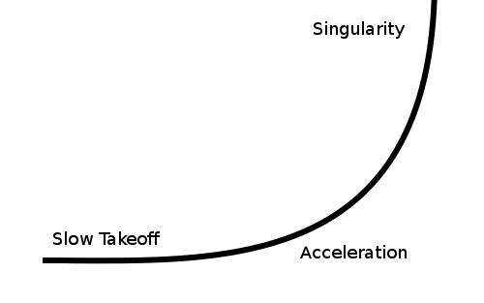
WIL has grown slowly and steadily...now it’s time to grow it exponentially
...But it won’t be easy.
Notes:
“Vast majority”... haven’t done it before.
We’re in the End Zone celebrating… and they’re not even on the field yet.
So we’re working down at the “slow takeoff” part of this curve
Hardest thing is to get from zero to something. Vs getting from something crappy to something incredible.

Slide 11
For example: Apprenticeships
It’s not as simple as saying we need more apprentices, more skilled tradespeople to fill labour market needs:
Following a national consultation, we found a profound generational divide, particularly in terms of digital literacy. What does that mean?
  Young apprentices prefer to communicate by text and email, while experienced journeypersons prefer to talk, teach, and mentor face to face.
  Training institutes struggle to keep up with industry (few can afford to buy autonomous vehicles to train students), while employers may not be able to invest in digital upskilling.
In other words, cost, geography (rural and remote), and tech adoption barriers persist and closing these gaps for employers, PSIs, and students will be critical if we want to expand experiential learning.
Notes:
We spoke to 175 apprenticeship stakeholders in various sectors across the country
Tradespeople identified a number of core 21st-century digital skills that are needed to adapt to the future of the trades. These skills require knowledge of digital tools, specific technical knowledge, and...wait for it...social/emotional skills (communication again), which evolve over a person’s lifespan.
In other words, tradespeople will need a range of new skills to keep pace with the future of work and to thrive in digitally connected workplaces.
Apprenticeships = Deluxe WIL. But no doubt we’ll see variations on the same themes across the different types of WIL.

Slide 12
What we’re doing to help
Filling gaps. Not duplicating efforts.
Creating a consolidated place for funding opportunities
Building tools and resources (in consultation with employers)
  Financial supports guide: for employers (with sector and region specific data).
  ROI: with steps and key factors to consider when determining the ROI on WIL
  Recruitment and onboarding guide: with insights from senior executives and curated tips and strategies to support effective engagement of PSIs and students.
  Mentorship guide: for managers/supervisors on effective mentorship strategies.
  Diversity and inclusion guide: for managers/supervisors on effective engagement EDI strategies related to WIL
  Assessment strategies guide: to support managers/supervisors’ ability to assess student learning and performance, including curated tools, tips, and strategies.
  Interactive map: to illustrate the location of promising WIL initiatives across Canada.
Notes:
Getting to 100% WIL:
Finding funding opportunities; and
Creating various tools and resources
On the first theme, this consolidated and centralized place for funding opportunities is a key deliverable that we’re working on at BHER (so more to come on this!)

Slide 13
Thank you!
Valerie.Walker@bher.ca

