Slide 1

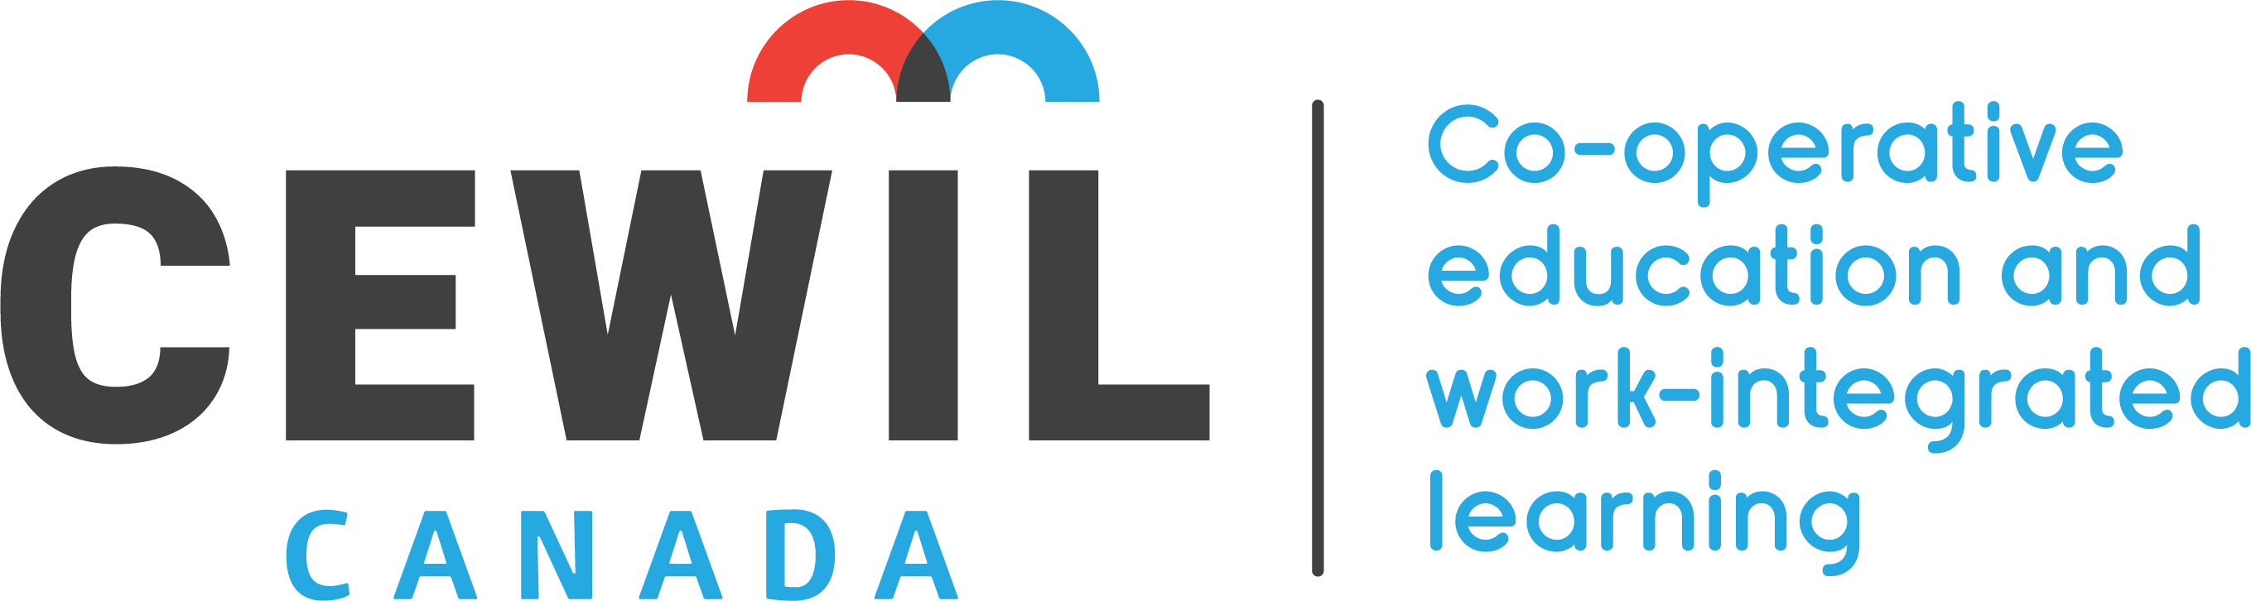

CEWIL Canada
TRENDS AND QUALITY WORK-INTEGRATED LEARNING: Developing adaptable and resilient students
Matt Rempel, President-Elect, CEWIL and
Director, Career-Integrated Learning, Sheridan

Slide 2



MISSION
CO-OPERATIVE EDUCATION &
WORK-INTEGRATED LEARNING (CEWIL)
Building the capacity to develop future-ready students through quality work-integrated learning

Slide 3
Work-Integrated Learning (WIL)
Work-integrated learning is a model and process of curricular experiential education which formally and intentionally integrates a student’s academic studies within a workplace or practice setting. WIL experiences include an engaged partnership of at least: an academic institution, a host organization and a student.
Types of WIL
Applied Research Projects
Apprenticeships
Co-operative Education
Entrepreneurship
Field Placement
Internships
Mandatory Professional Practicum/ Clinical Placements
Service Learning
Work Experience

Slide 4
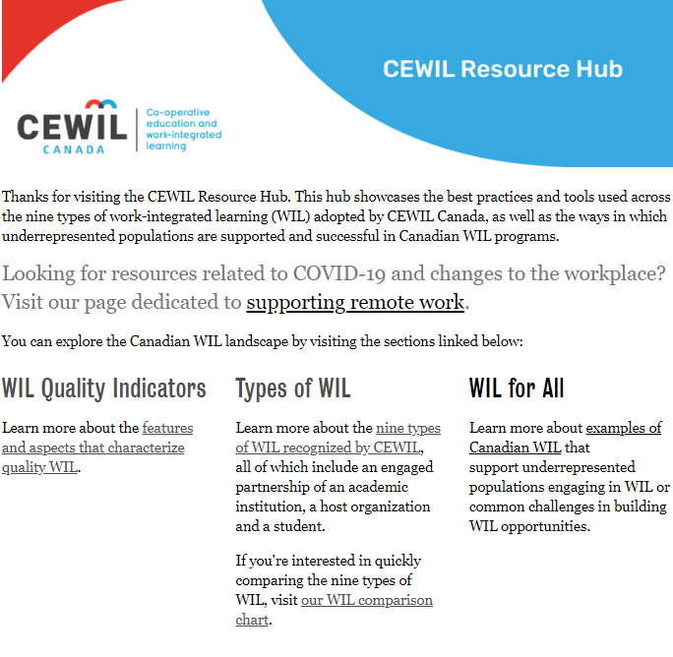
CEWIL Quality Council & Accreditation
Global leadership as a national accreditation process
Over 50+ institutions have received program Accreditation by CEWIL
Accreditation: Co-op programs must provide documentation demonstrating:
  structural criteria
  co-op in the institutional context
  institutional commitment criteria
  quality program delivery criteria
  monitoring and evaluation criteria
Introduced a Quality Council for Canadian WIL post-secondary programs

Slide 5


March 2020 … everything changes

Slide 6
CEWIL COVID Data
Data: Summer placement rates as of July 16 reported by 55 WIL programs from 37 schools (majority co-op programs) & 46 WIL programs at 36 schools for Fall placement rates.
Data: Institutional job board postings reported by 17 schools August 2019 vs 2020

Slide 7

Adapt and become resilient #YesWeWIL

