Slide 1
Ti wa7 szwatemem: What we know. Indigenous knowledge and learning in the academy
Ontario Universities Council on Quality Assurance
2020
Dr. Lorna Wanosts’a7 Williams, Lil’watul
Professor Emerita, C&I Indigenous Ed
CRC Indigenous Knowledge and Learning
University of Victoria

Slide 2
Kukwstúm’cwi, K’alan’wi
Nsnúk’wnuk’w7a
Kukúpi7a
Kekla7lhkálha
Apa7
Kika7
All the language champions and knowledge keepers present and at home
I acknowledge the people and the ancestors on whose lands we gather today.

Slide 3
Kukwstum’ckal’ap nsnukw’nukw7a
Thank you to the ancestors whose spirits are on this land and the people who care for this land, we come with good thoughts and spirits. Kukwstum’ckacw apa7 for starting us in a good way. And to the organizers for bringing us together

Slide 4
ELTLNIWT (Sencoten)
To be a whole human being
Holistic knowledge – all knowledge is inseparable from land, place, spirit, language, kin, law, balance, harmony, respect
Spirit, heart, body, thinking
Ancestral knowingness
Notes:
All societies design an educational system that will ensure that they will continue and exist

Slide 5
k’é (Diné)
understanding interdependent, compassionate relationships as they manifest in life
  earth - sky
  self - family - community - nation
  animals, plants
  ancestors - descendents

Slide 6
Assaults and insults on our bodies, spirit, minds families, nations
Disease
Forced separation policies
Forced disconnection from life on our lands
Racism
Voiceless, invisible, storyless, purposeless

Slide 7
Canadian and Colonial Context for Indigenous language revitalization
Ideology of contempt – single story, single language, single standardized language, “if my child learns my language will it harm them, keep them from learning and employment?” Science, philosophy
Language Social Darwinianism – Survival of the fittest, Only National languages are worthy and superior to all other languages. Loether, Kroskrity and Field (2009).
English is a universal language, best tool for communication and most convenient
Standardization – best way to revitalize a language is to choose one dialect and writing system, humans can’t cope with variability. How did our ancestors deal with variability?
Notes:
Loether, Kroskrity and Field Native American language ideologies: beliefs, practices and struggles in Indian Country, 2009
PM108 N28 McPherson Library

Slide 8
Interruption
How the world sees and judges Indigenous peoples - less than, childlike, unsophisticated, uncivilized, endangered, marginal,
Habits of practice – exclusion, silencing, separation, non existence,
Western view of the world – hierarchy, fragmentation, separation, siloing, stratification, status,

Slide 9
legacy
Disruption of intergenerational relationships; language, wisdom
Discontinuation of ceremonies, relationships with ancestors, descendents, spirit
Disruption of relationships with the land, protection of land, animals, plants
Disruption of sovereignty and governance
Dehumanization, demonization

Slide 10
Legacy
Indigenous knowledge and wisdom:
  Invisibility
  Devaluation
  Irrelevant, unnecessary
  demeaning
  Fear and abhorrence
  mistrust

Slide 11
Education, learning and teaching – key to our continuation and existence

Slide 12
Decolonization, understanding the effects of colonization

Slide 13
Education a tool of colonization
Separate children from parents, family, community
Separate children from the land
Learn in a fragmented, disconnected silo
Learn shame, silence,
Learn to distrust own knowledge and wisdom
Learn to leave knowledge and experiences at the door both going in and leaving school
“How can I get an education without giving up who I am and what I know?”

Slide 14
Shifting, Border Crossing
Indigenous world to Euro western academic world and back again
  Starting point – traditional knowledge, concepts, processes, from itself
  Awareness that traditional knowledge is always interacting with modern world, colonialism

Slide 15
SHIFTING
Indigenous knowing, knowledge and wisdom – colonized thinking
Oral traditions to literate traditions
Sharing to saving
Communal relations to individualism
Returning to the community and to the Indigenous world

Slide 16
“WE ARE TRYING TO PUT TOGETHER A MIRROR SHATTERED INTO A MILLION PIECES” ANGELINA STUMP

Slide 17
Indigenous Knowledge, Learning and teaching

Slide 18
WISDOM AND KNOWLEDGE
Bring your knowledge bag with you
Don’t be afraid to ask your ancestors for help
Knowledge is not only found in books

Slide 19
Líl’wat Principles of learning
Cwelelep – being in a place of dissonance, uncertainty in anticipation of new learning, to spin like a dust storm
Kamucwkalha – the felt energy indicating group attunement and the emergence of a common group purpose, group is ready to work together, to listen to one another and speak without fear
Celhcelh – each person is responsible for their learning, it means finding and taking advantage of all opportunities to learn, and maintain openness to learning. Each person must take the initiative to become part of the learning community by finding their place and fitting themselves into the community. It means offering what knowledge and expertise you have to benefit the communal work being carried out
Emhaka7 – each person does the best they can at whatever the task, and keeps an eye on others to be helpful. To work respectfully and with good thoughts and good hands

Slide 20
Líl’wat Principles of Learning
Responsibility – each person is responsible for helping the team and the learning community to accomplish the task at hand in a good way, entering the work clear of anger and impatience
Relationship – throughout the course each person will be conscious of developing and maintaining relationships - with the people, the task, the teachers and guides, and the communities beyond the learning community. It also means relating what you are experiencing to your past knowledge and to what you will do with what you are learning.
Watchful listening – an openness to listening beyond our own personal thoughts and assumptions, being aware and conscious of everything around you as you focus on the task at hand
A7xekcal - how teachers help us to locate the infinite capacity we all have as learners. Developing one’s own personal gifts and expertise in a holistic, respectful and balanced manner.
Kat’il’a - finding stillness and quietness amidst our busyness and need to know

Slide 21
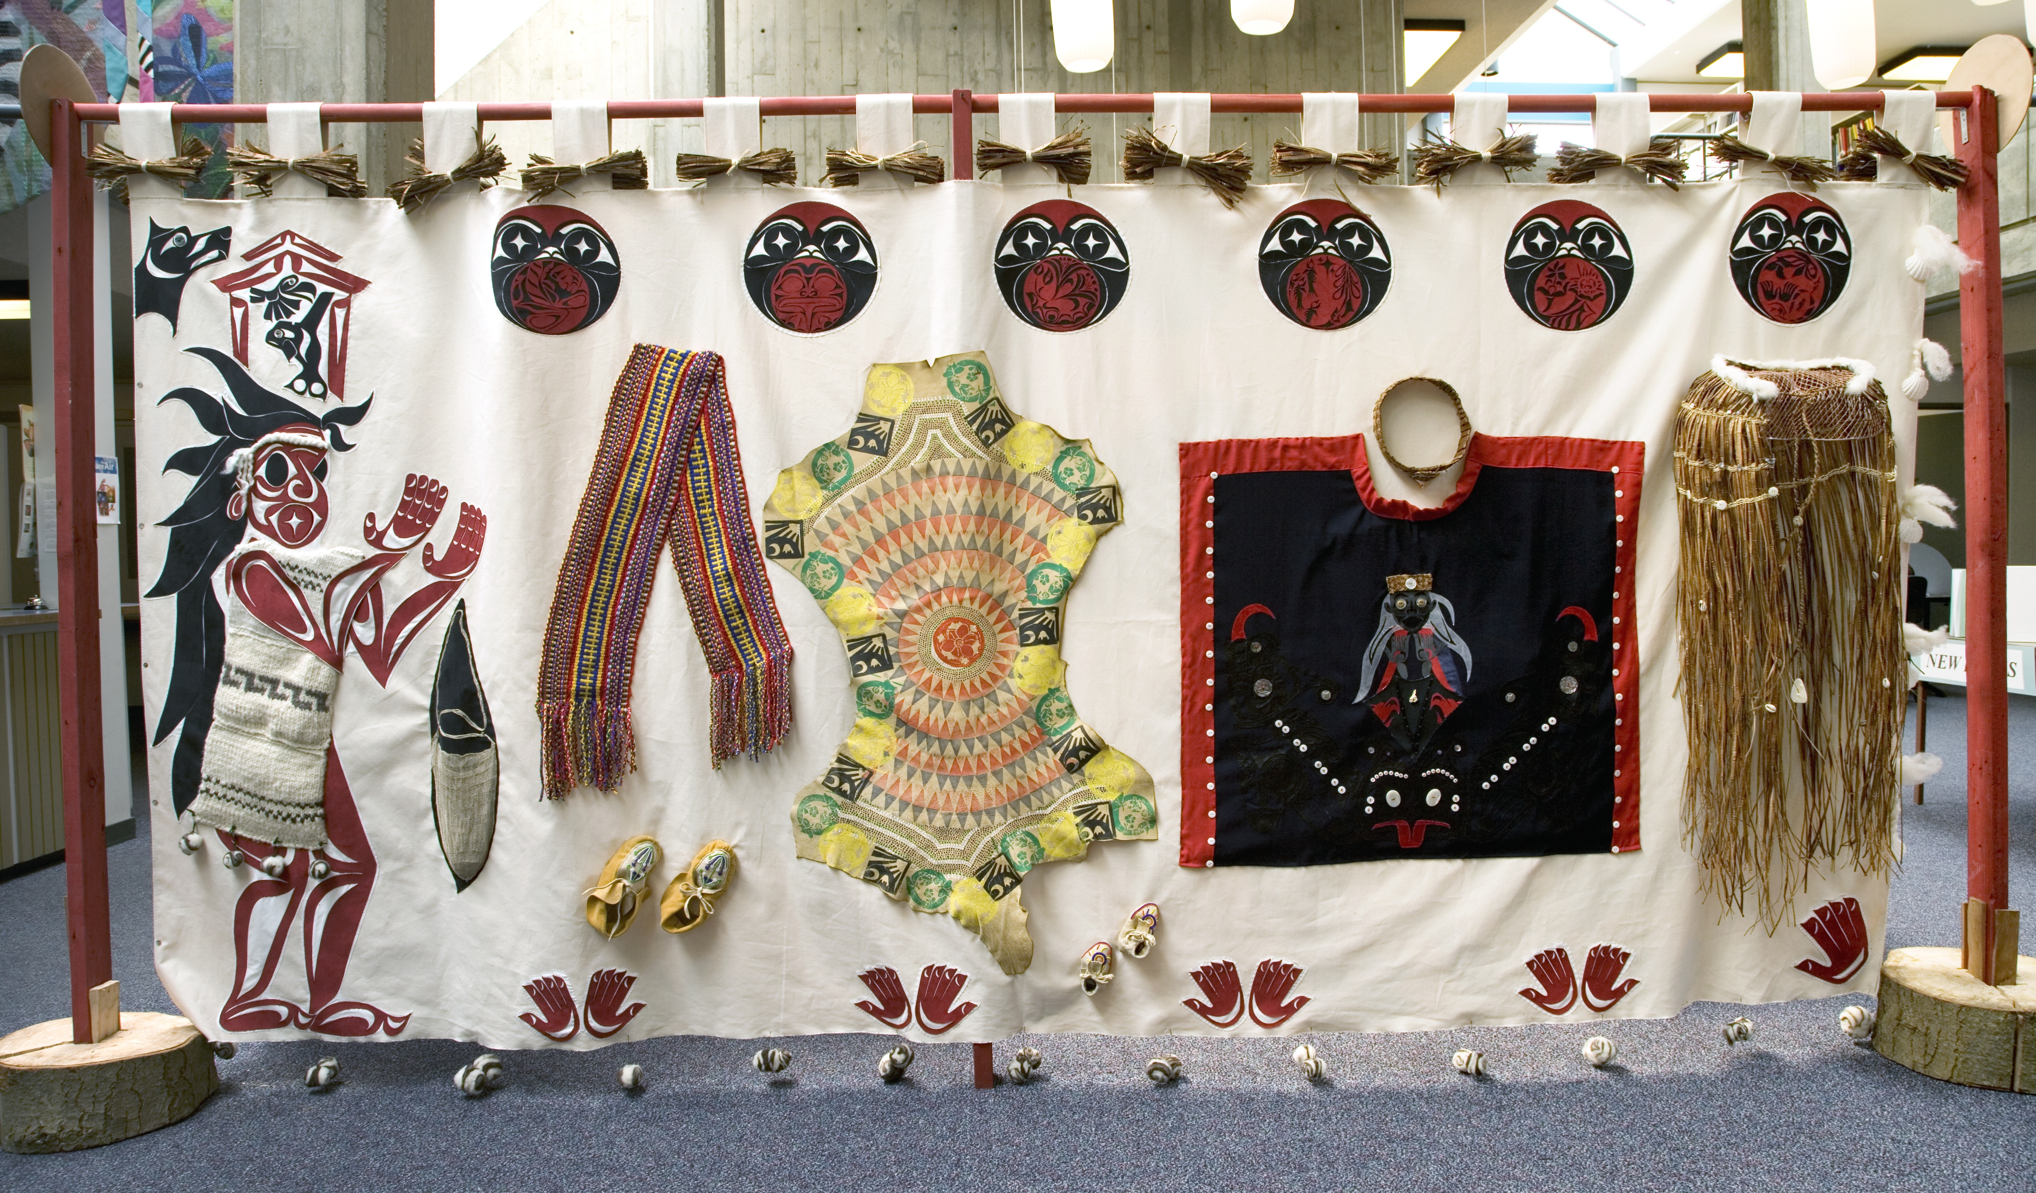
Woman’s knowledge & wisdom

Slide 22
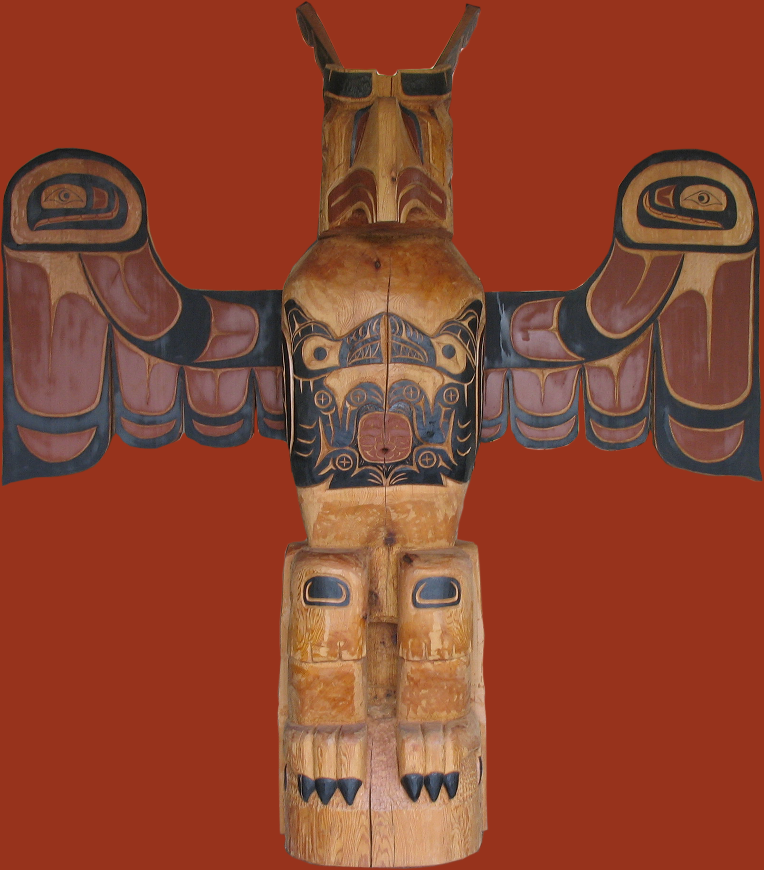
male
knowledge
wisdom

Slide 23
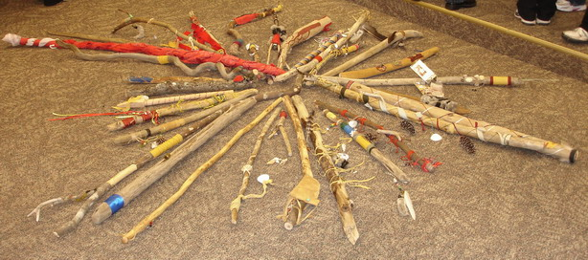
Story circles

Slide 24
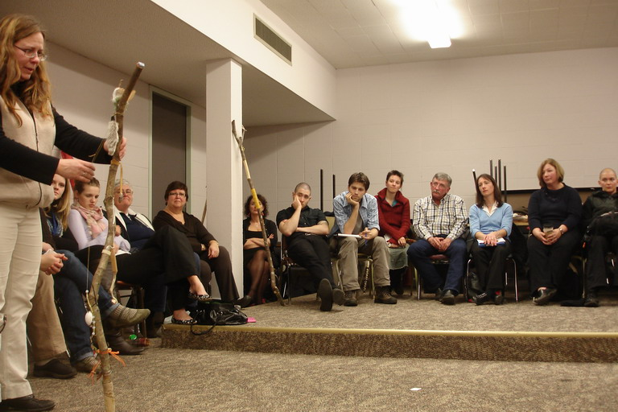
Telling my story knowing my story

Slide 25
Indigenous learning
Patience
Emhaka7 – good hands - Perfecting abilities in your own way
Hard work, effort, satisfaction from accomplishment
learning to focus, deep concentration, completion
Asking for help, help with out asking
Experiential, hands-on, doing

Slide 26
The more the individual uniqueness is honoured the stronger the community

Slide 27
How can we stay true to our way of being in the world as we recover, revitalize and sustain our traditions, cultural knowledge and practices?

Slide 28
Direct, authentic Indigenous involvement in development and implementation
Uncovering and recovering knowledge and practice in the fields of study.
Listening and striving to understand the vision of Indigenous peoples for area of study
Flexibility to find alternatives to meet both needs

Slide 29
Indigenous aligned services and resources to support learning
Oral/written
Program schedule
Sensitive to students’ multiple responsibilities
Mentoring
Using class projects and assignments to research and delve into challenges faced in communities
Utilizing the class (cohorts) as a source for networking and support – nuk’antwal’

Slide 30
Finding FACE
Visibility and presence within the educational institution
Value Indigenous knowledge and wisdom
Bridging Indigenous World and Western modern world (development of both)
Should we? Can we? How? Possible?
Notes:
Indigenous knowledge and wisdom:
Invisibility
Devaluation
Irrelevant, unnecessary
demeaning
Fear and abhorrence
mistrust

Slide 31
Indigenous Learning
Respect for relationships
Make a difference for self, family, community
Learning is for the community, self, responsibility
Sharing, giving, responsibility

Slide 32
Who am I?
The stronger my sense of identity, the more capacity I have to withstand, make sense of, and to cope with racism, learning in a foreign setting, adapting to new worlds,

Slide 33
Research
Relevant research is needed from an Indigenous perspective
Research practices that promote success
Indigenous people are required to conduct and guide research
Support to conduct appropriate research is needed from all institutions

Slide 34
Making Space
Policies and Practices Habits and Attitudes that support or exclude Indigenous Knowledge, wisdom, practice
- such as time, assessment practices,
expertise, knowledge source,

Slide 35
Having Place
Connectedness to the land, ancestors
Relationships,
Songs, stories, knowledge, wisdom, teachers, spirit
Community, histories, realities

Slide 36
Learning and Teaching in an Indigenous World
Experiential, practical, connected to earth
Relational, Learning community
Non graded, time, self initiated
Learning benefit for self and community
Meaningful and purposeful
Oral traditions, song, story, ceremony
wholistic - spirit, emotion, cognition, physical
To be a good human being

Slide 37
HOW IS SUCCESS DEFINED?
HOW IS SUCCESS
RECOGNIZED? ASSESSED?
How is success defined in the Indigenous world?
whose benefit?
Notes:
Work in pairs or triads, post definitions 5 minutes

Slide 38
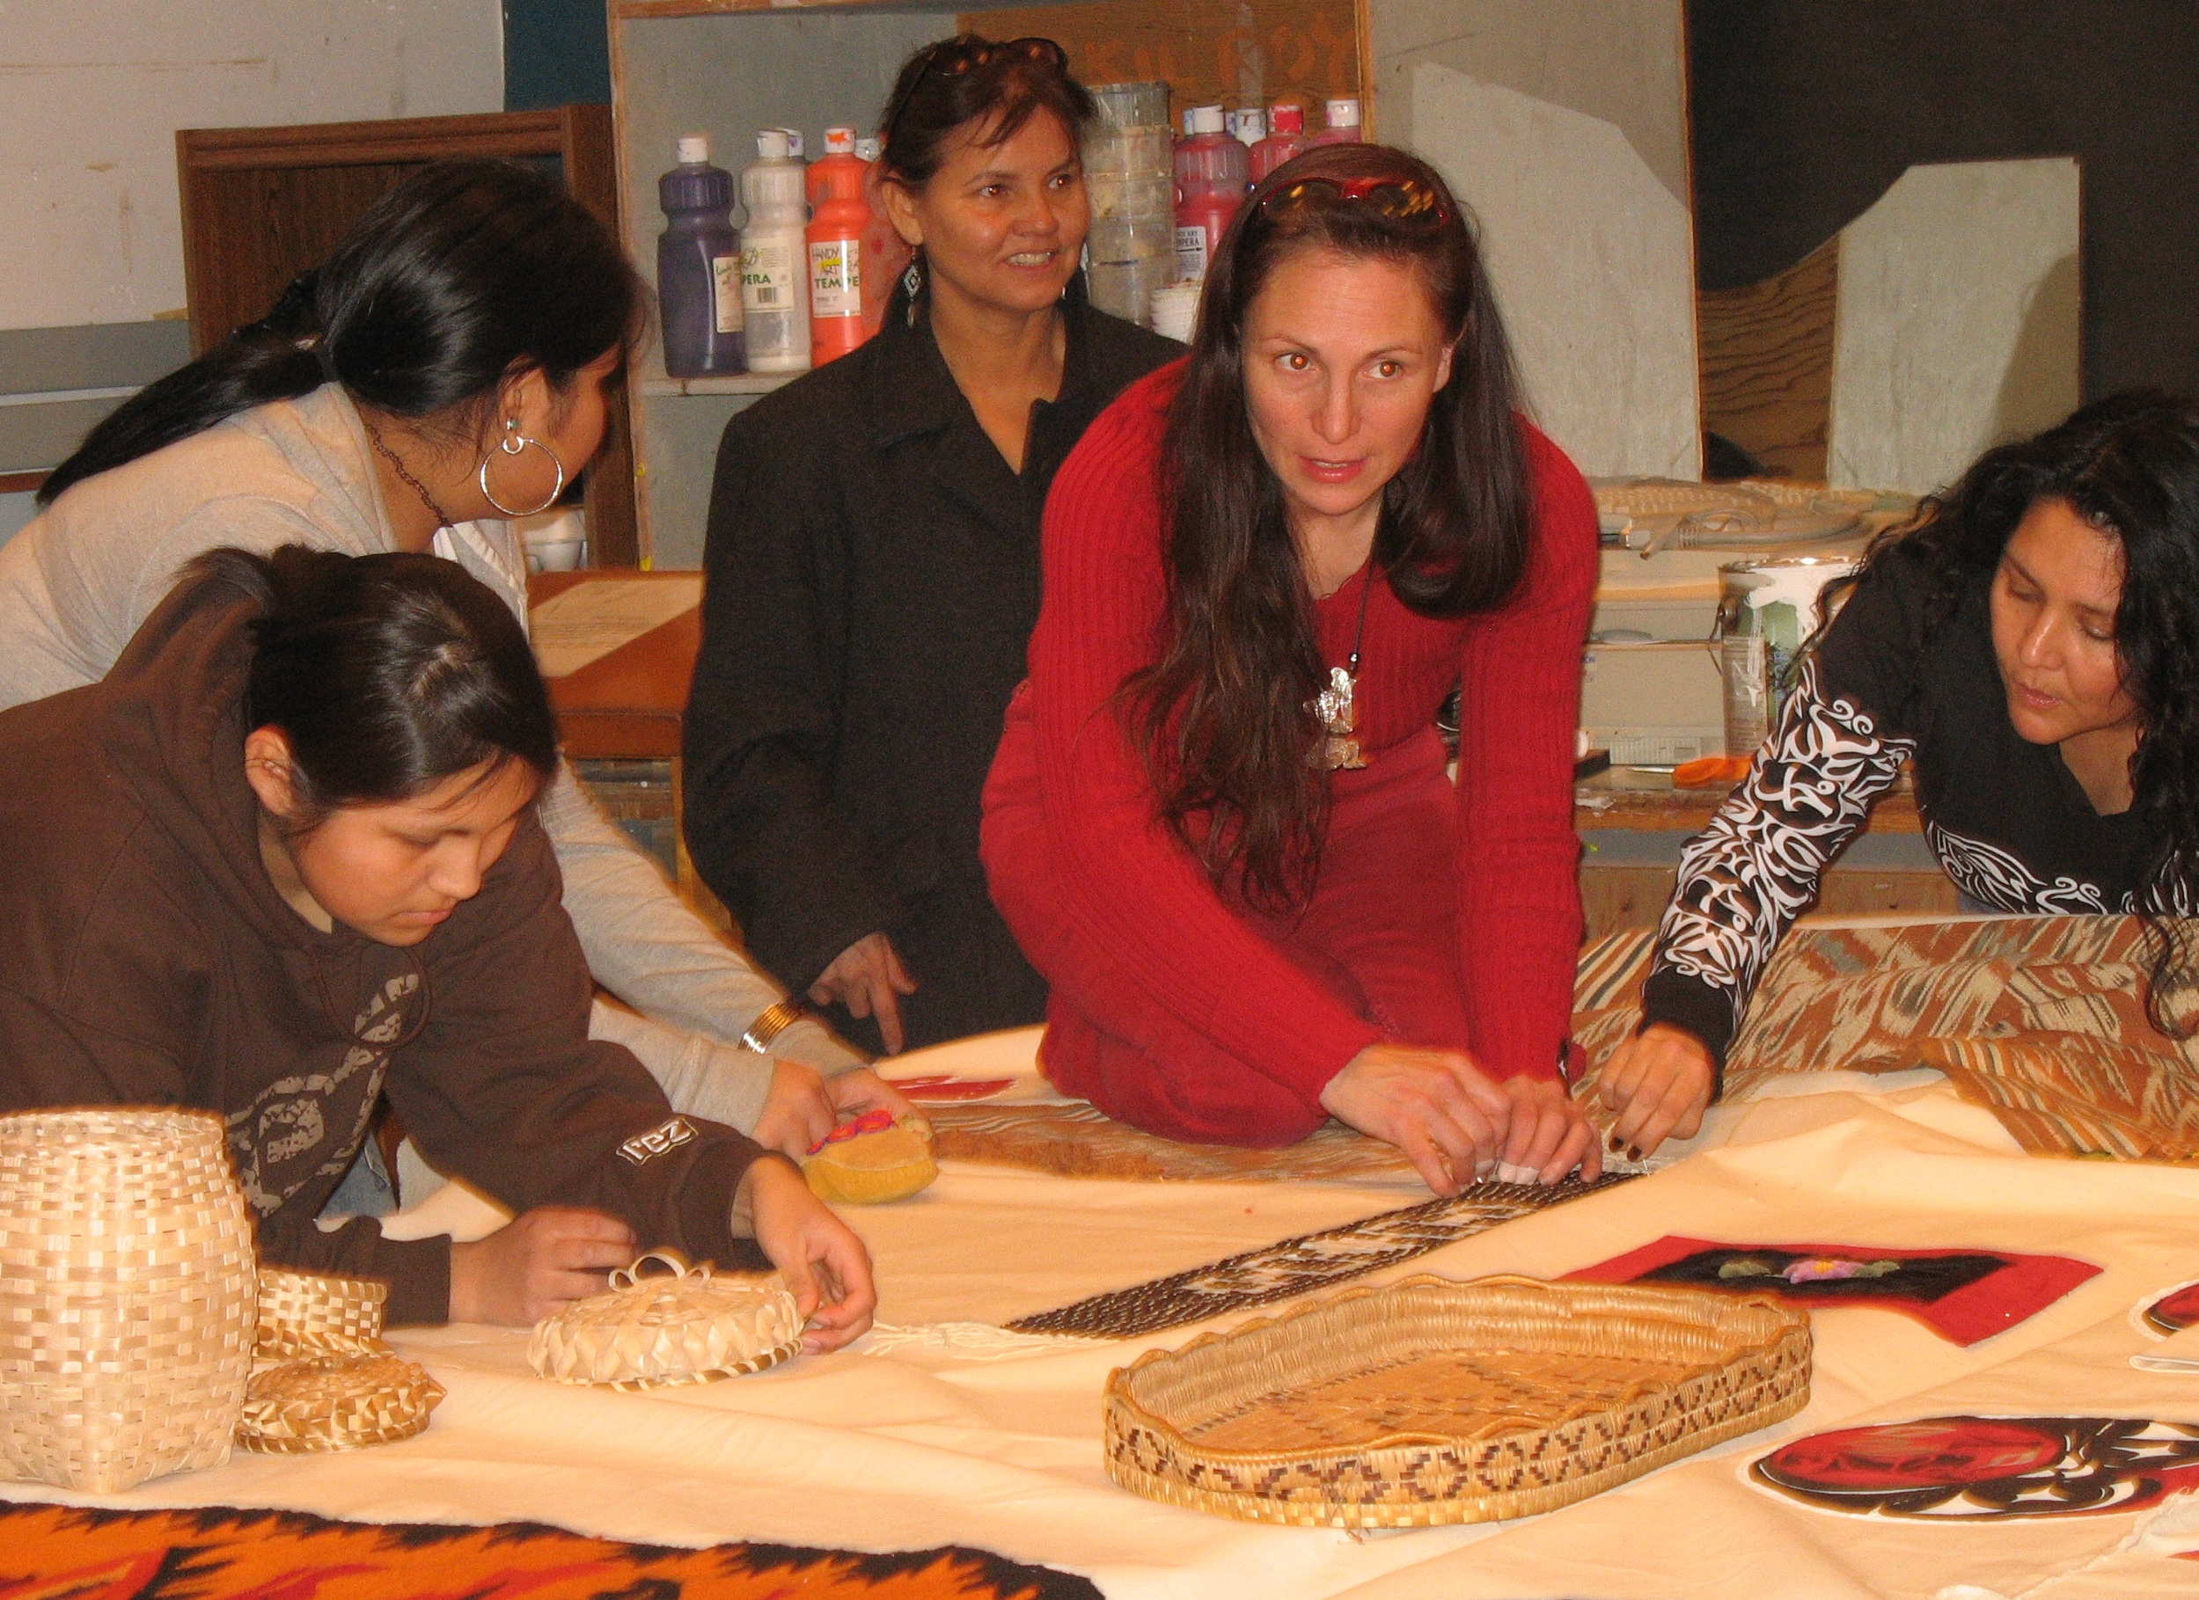
Sharing Our Ways of Knowing

Slide 39
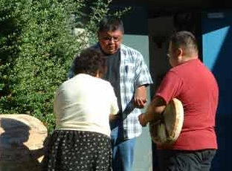
Learning Through Ceremony

Slide 40
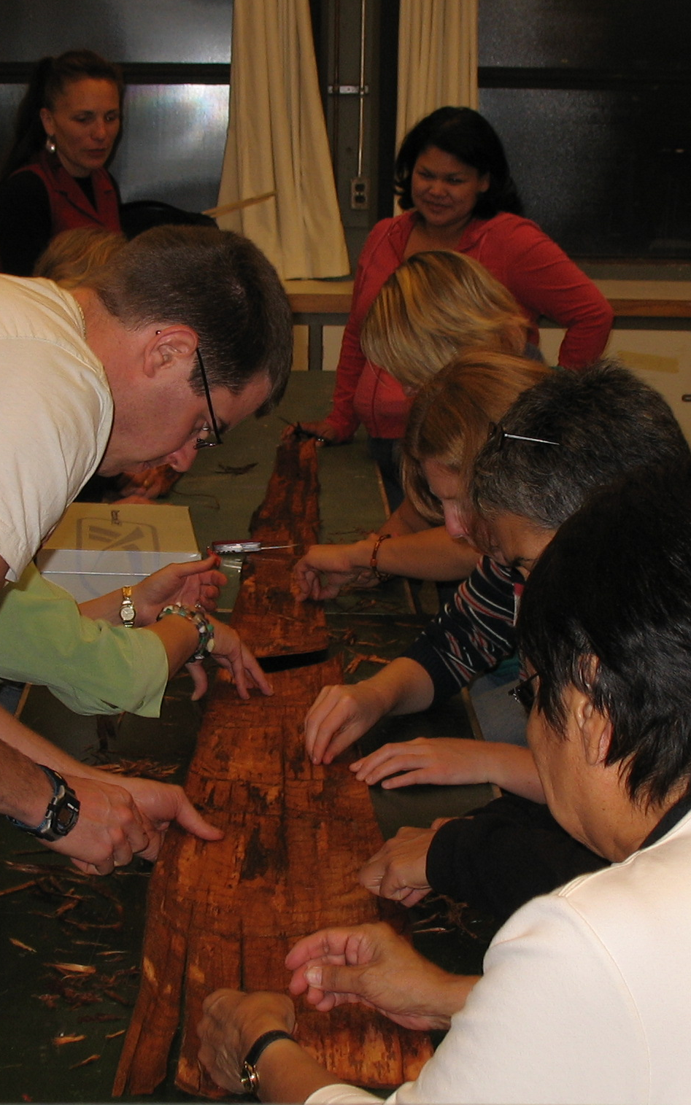
Learning
Through
Doing

Slide 41
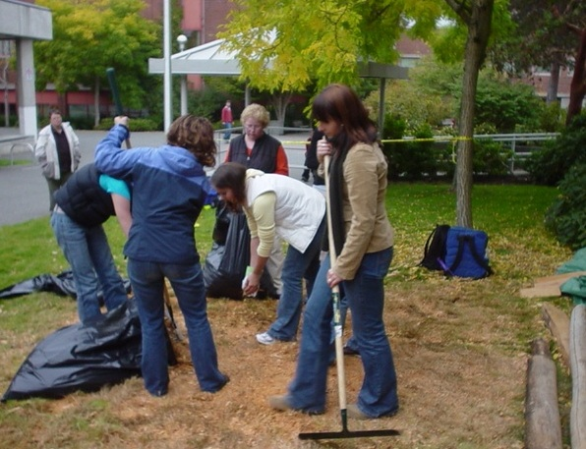
Learning
Through
Service

Slide 42
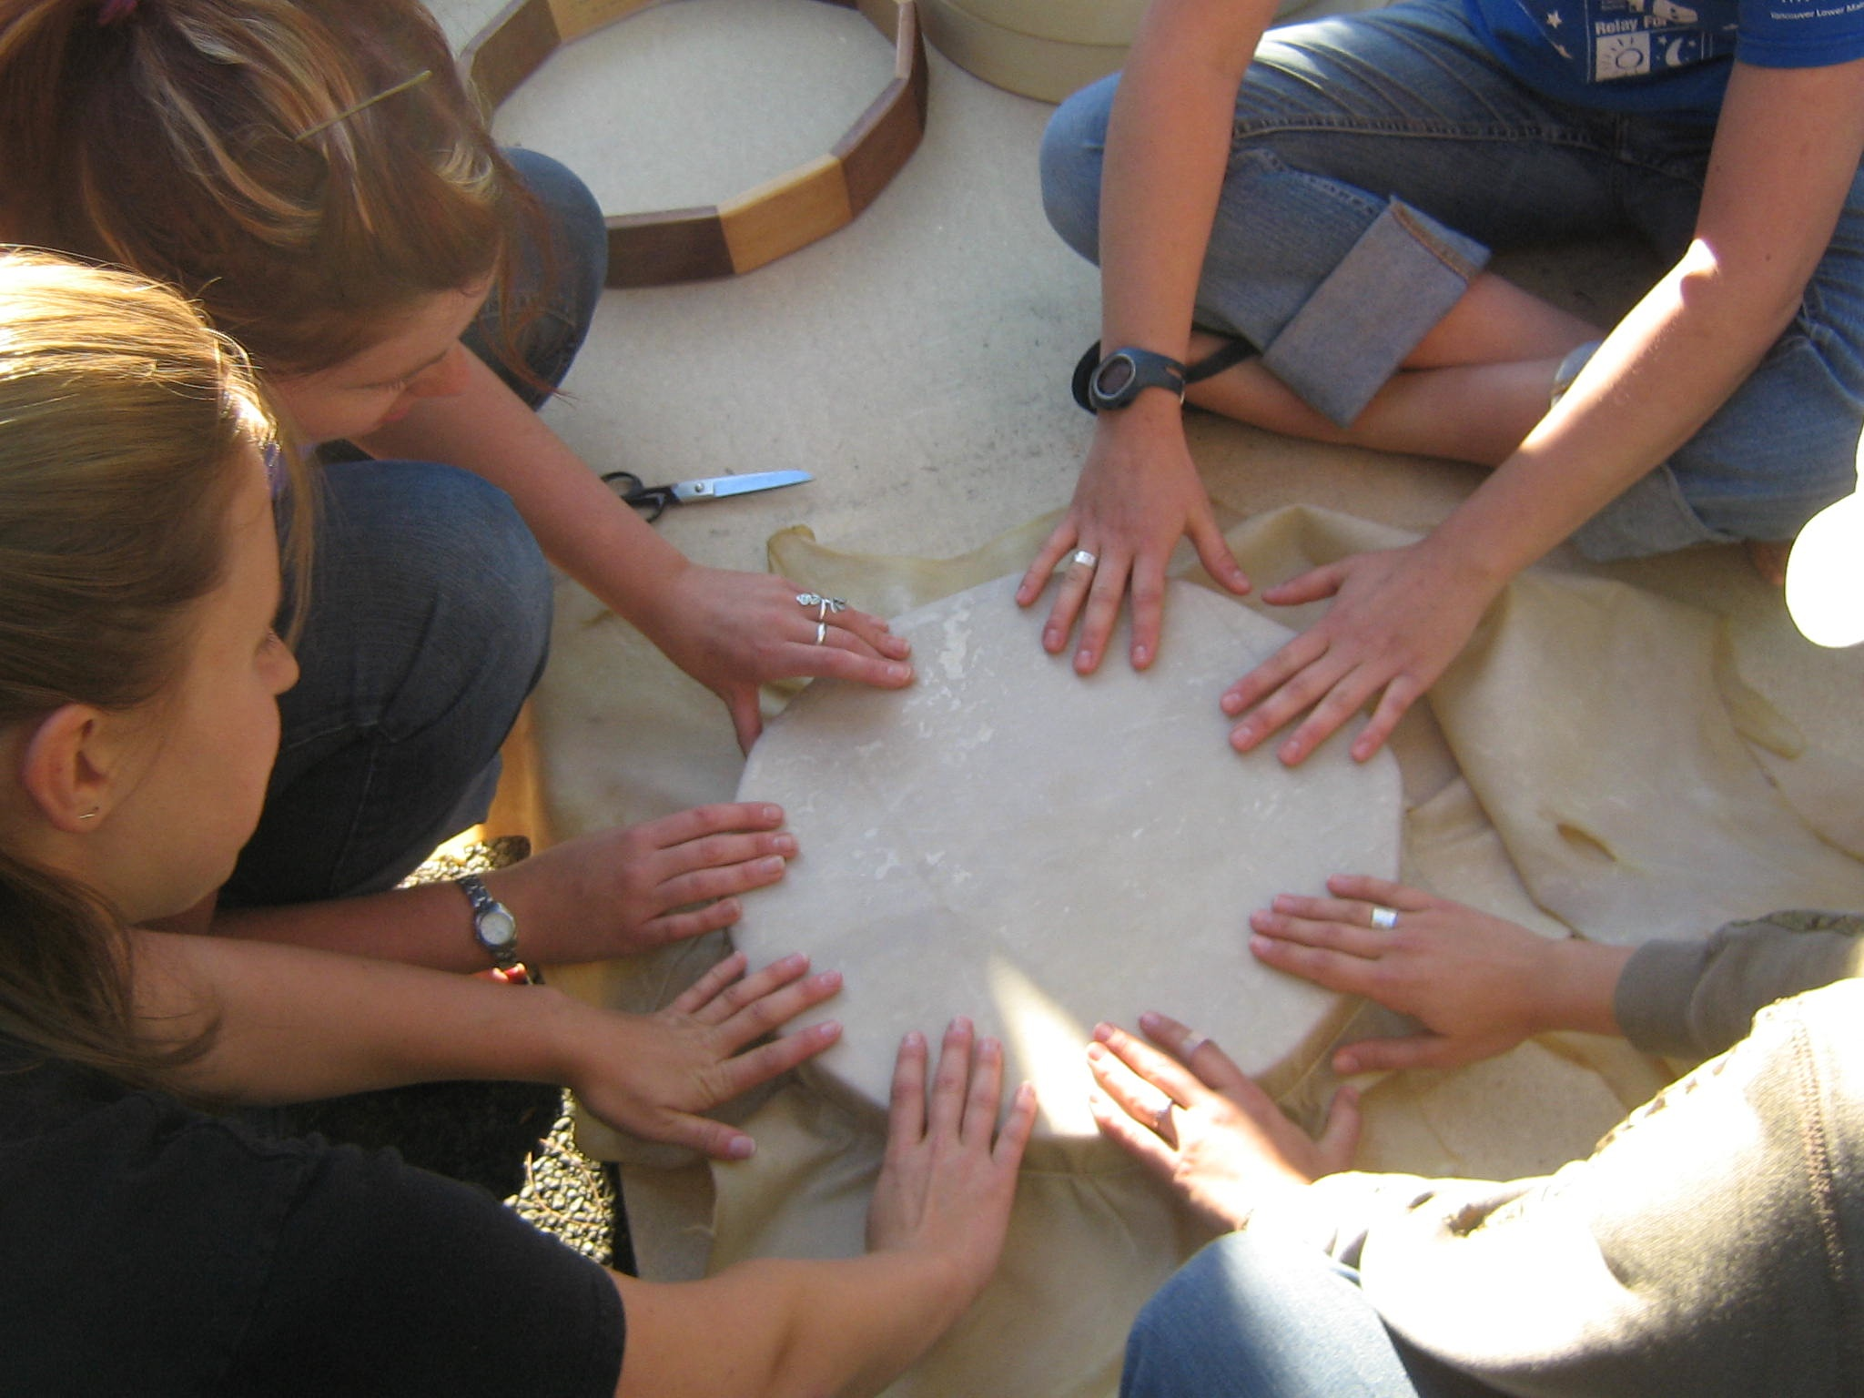
Reconnecting, remembering
Together in community

Slide 43
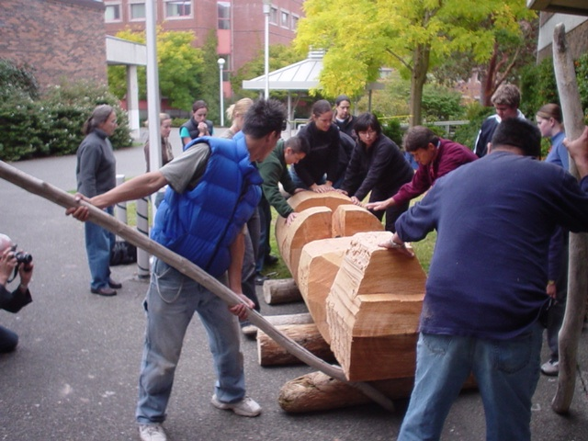
Kamucwkalha

Slide 44
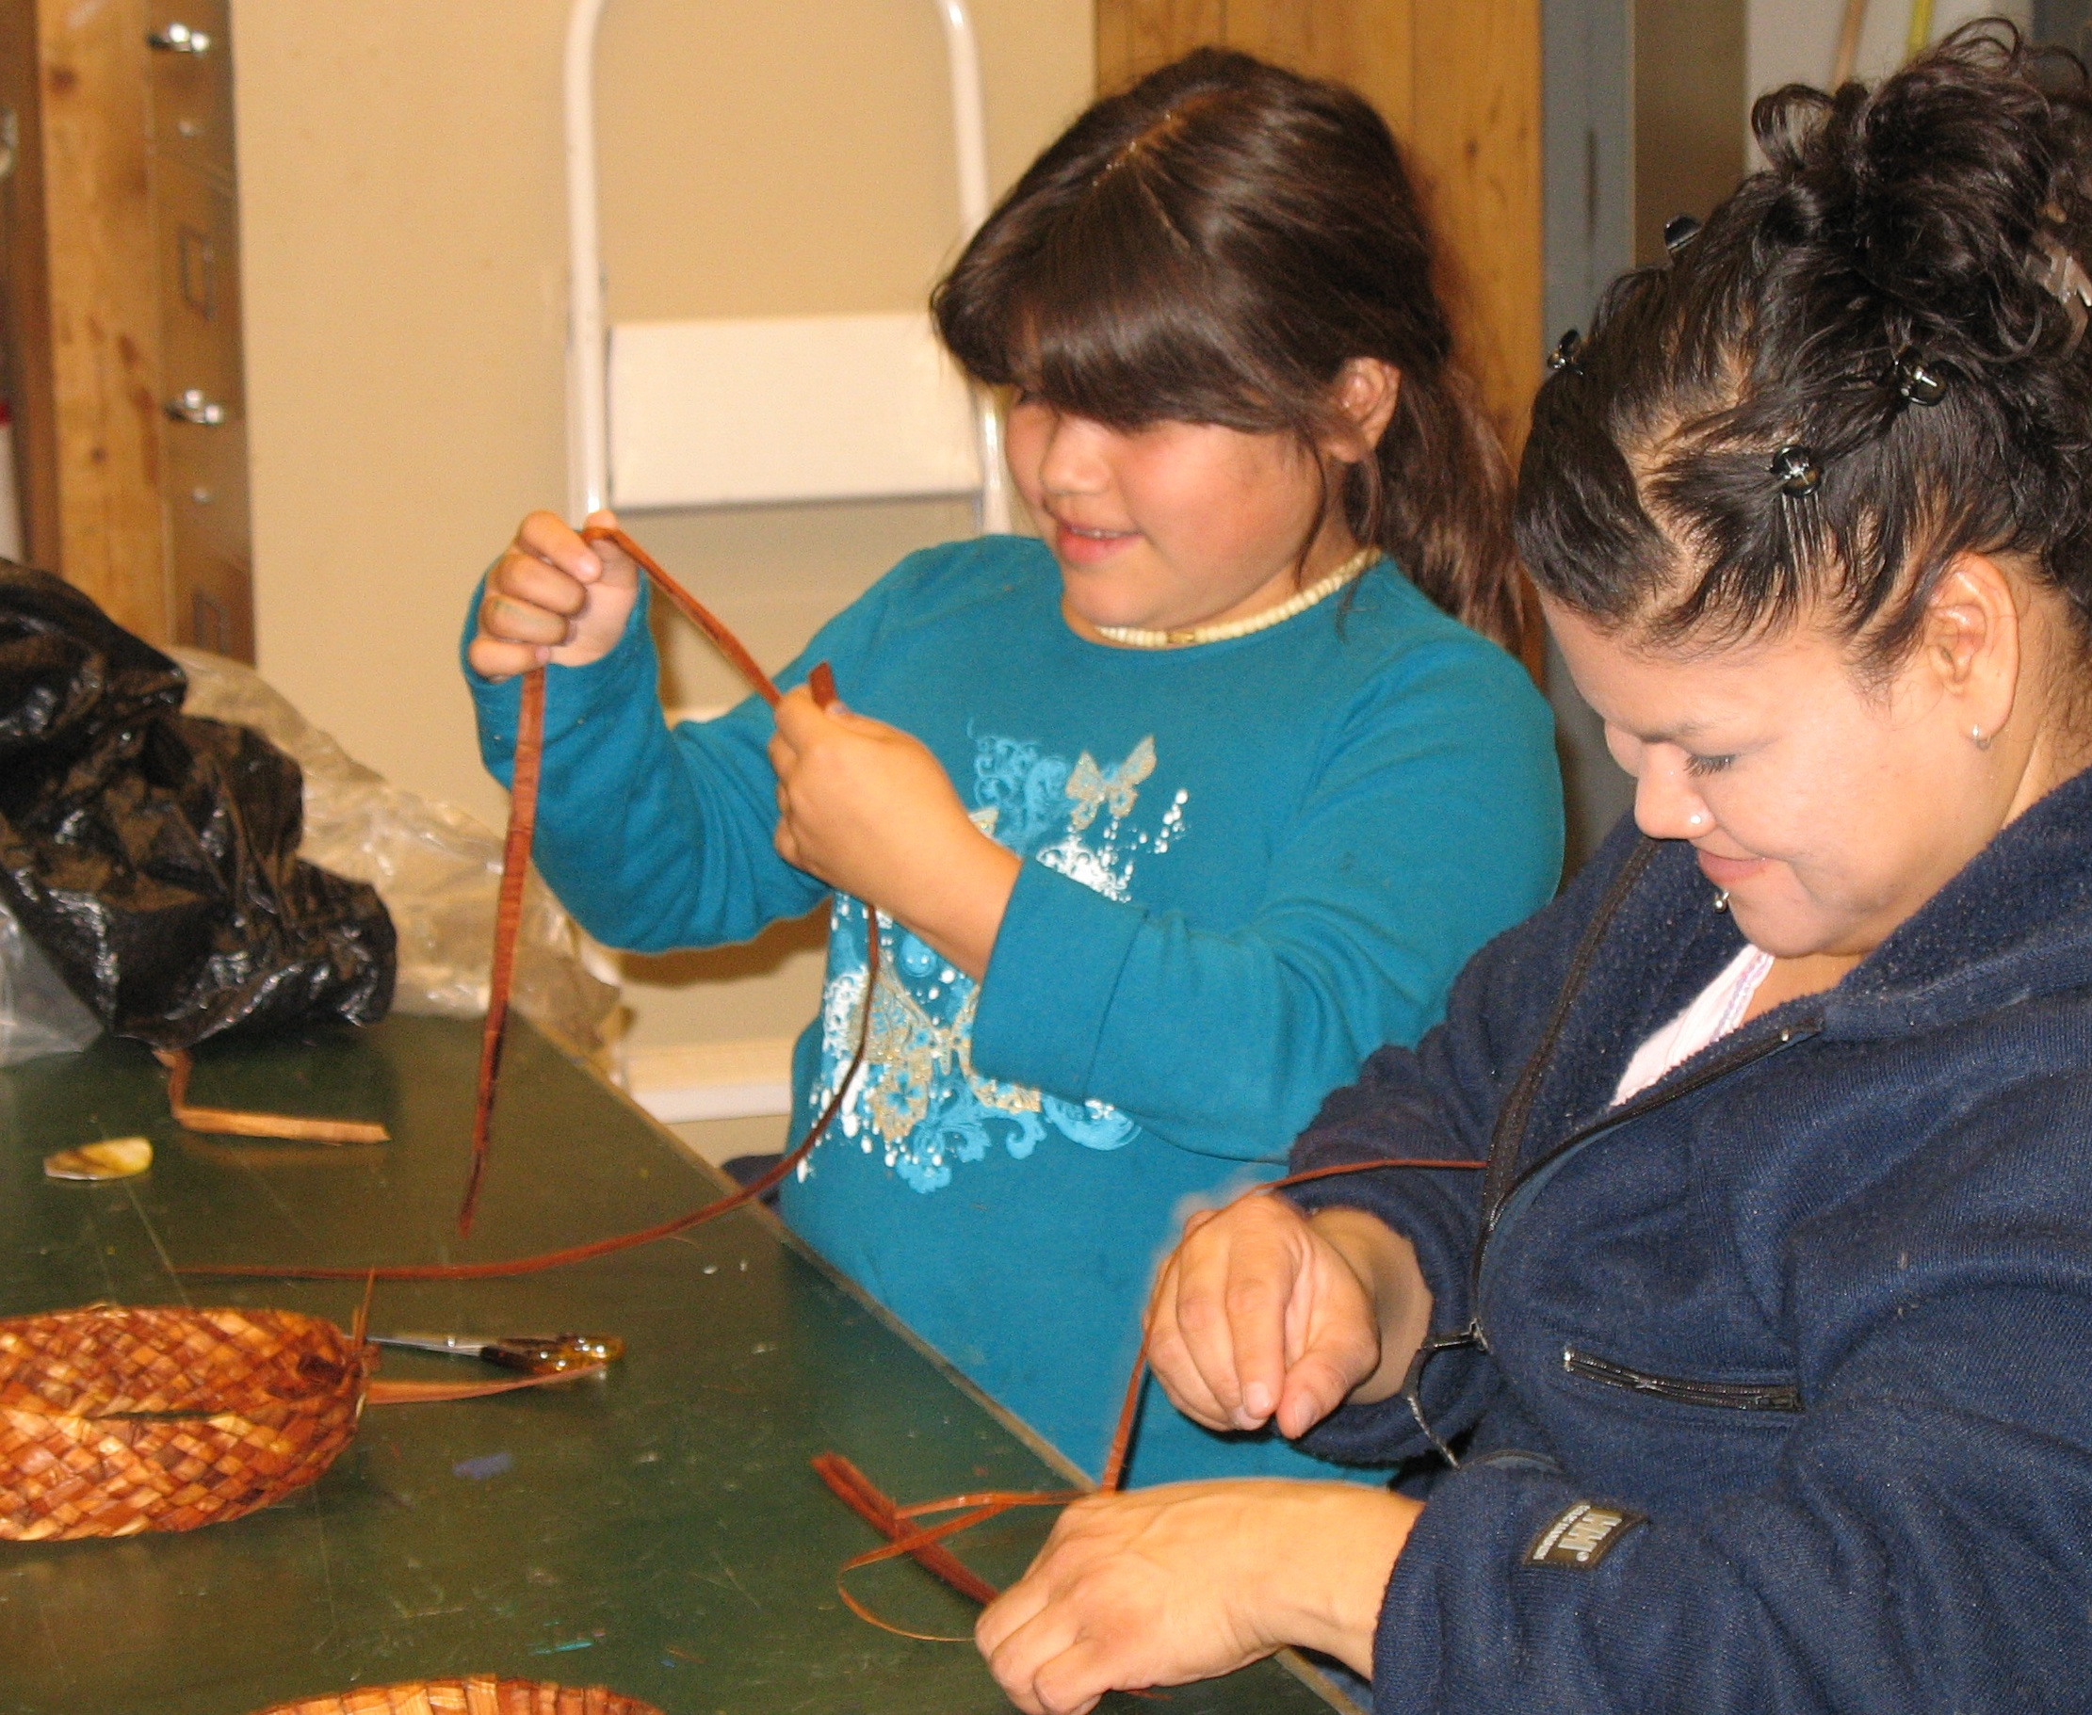
Connecting Generations

Slide 45
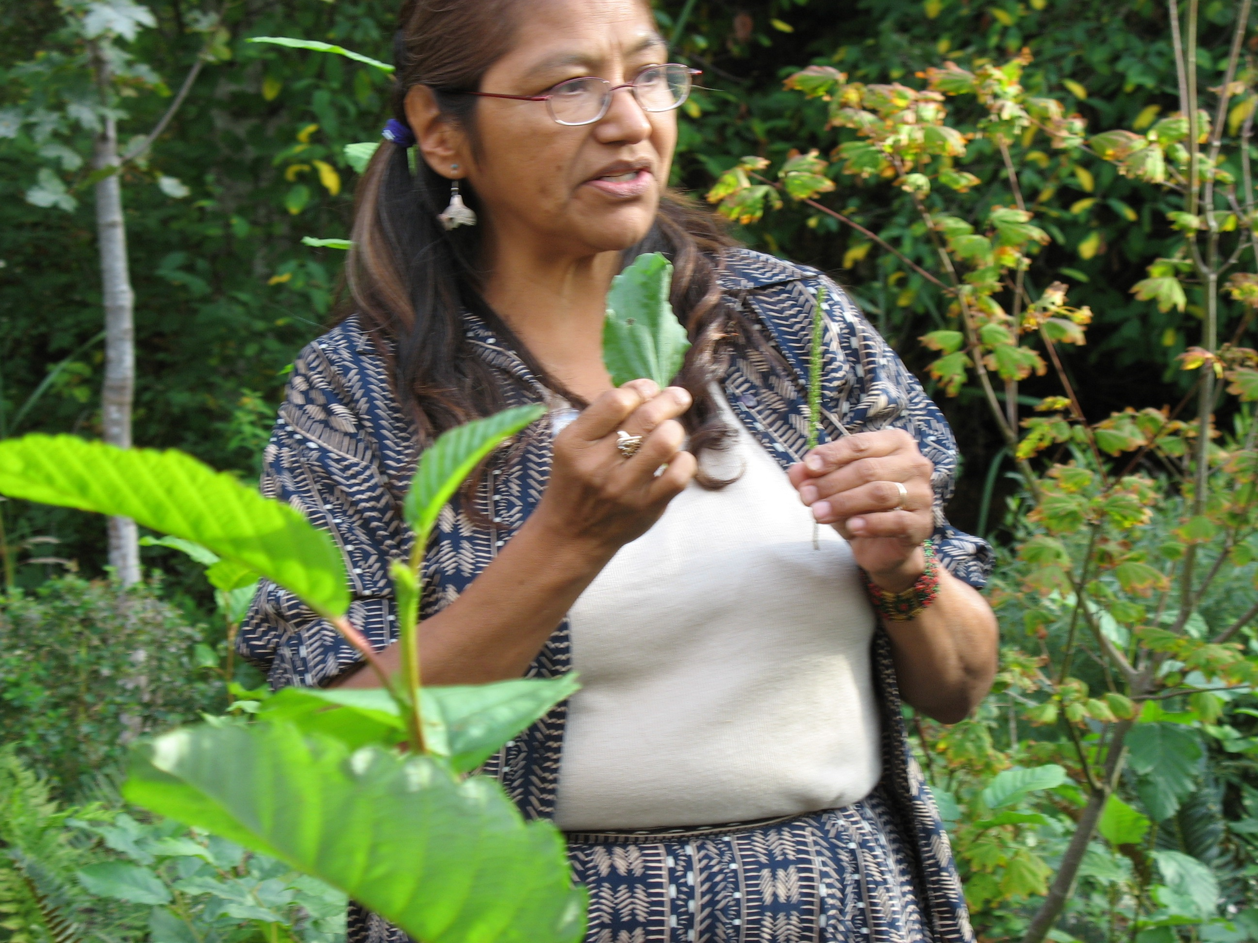
Identity and Learning from the
Land

Slide 46
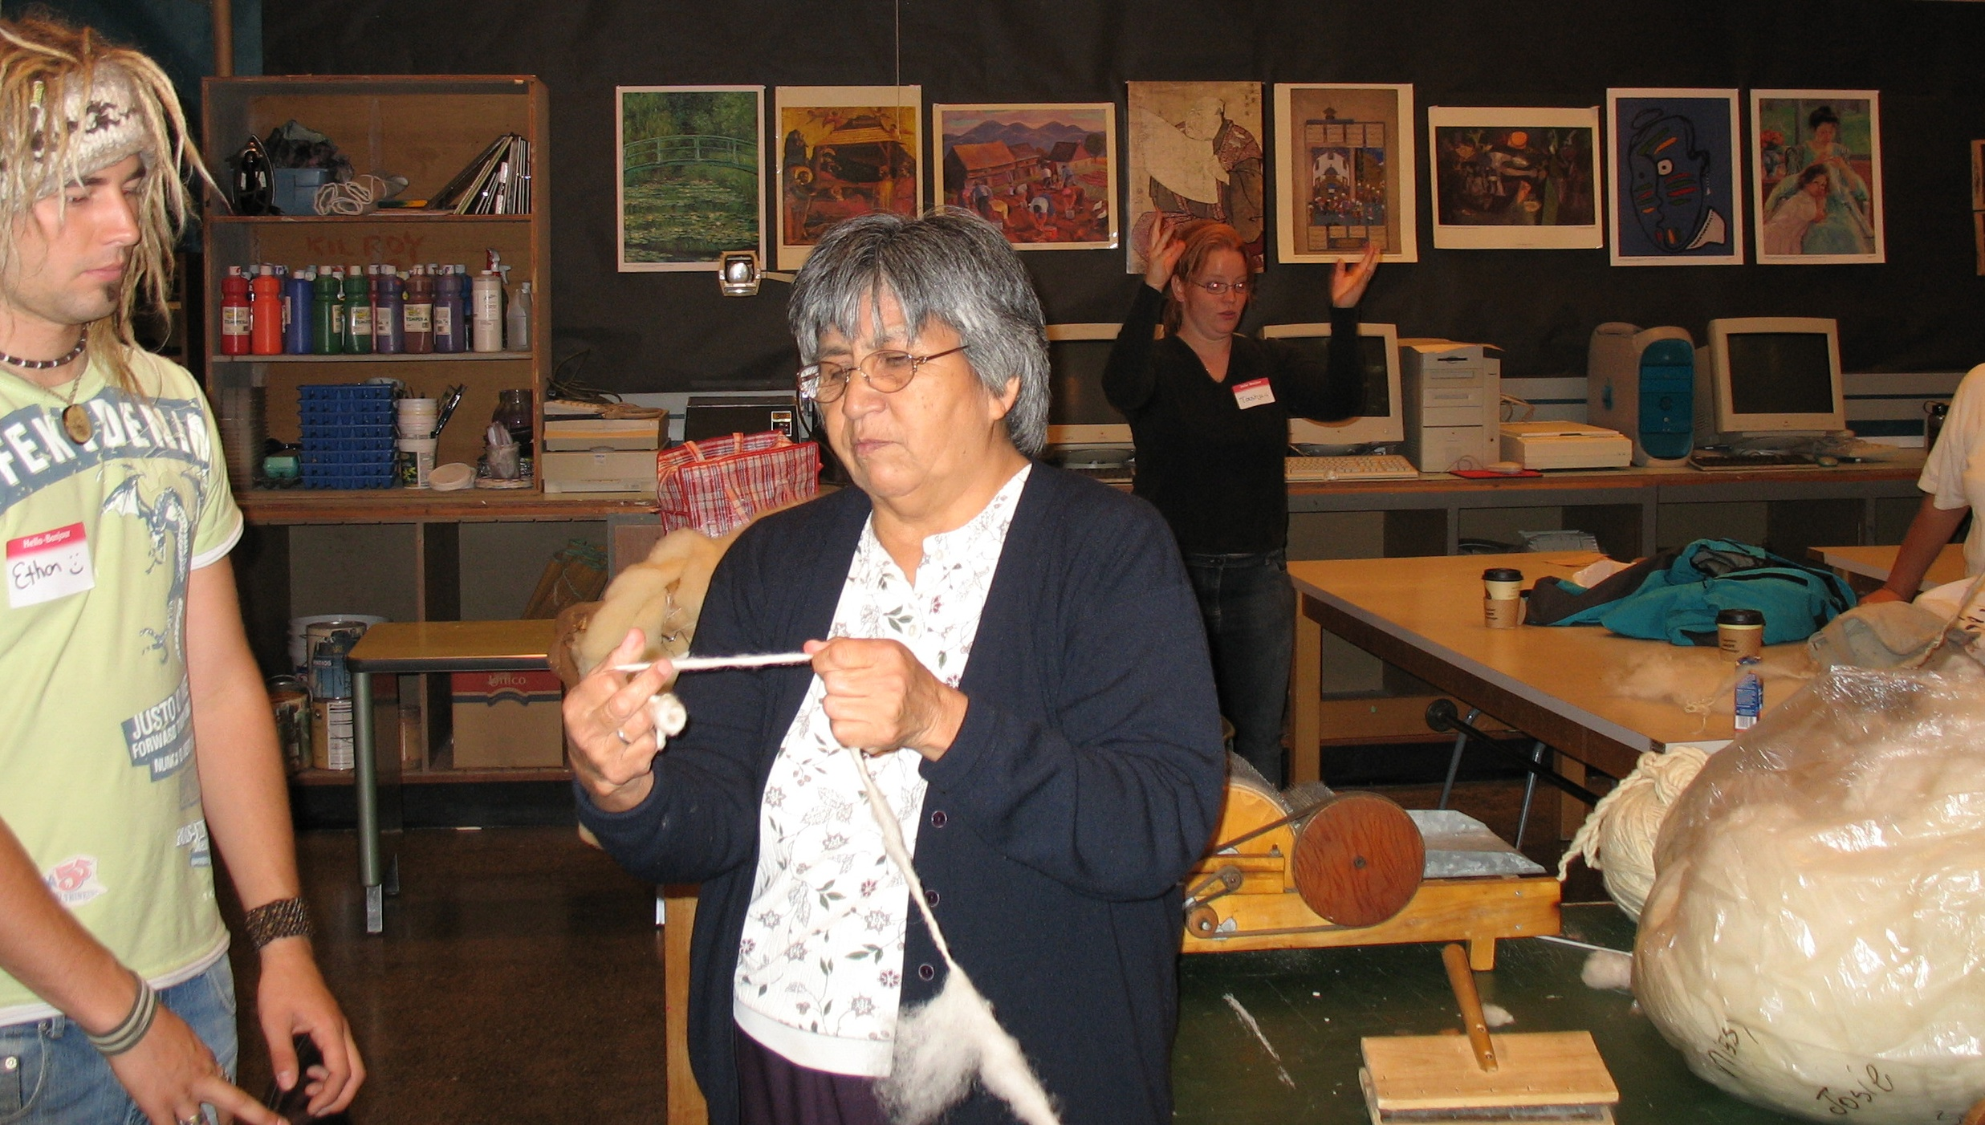
Knowledge Keepers

Slide 47
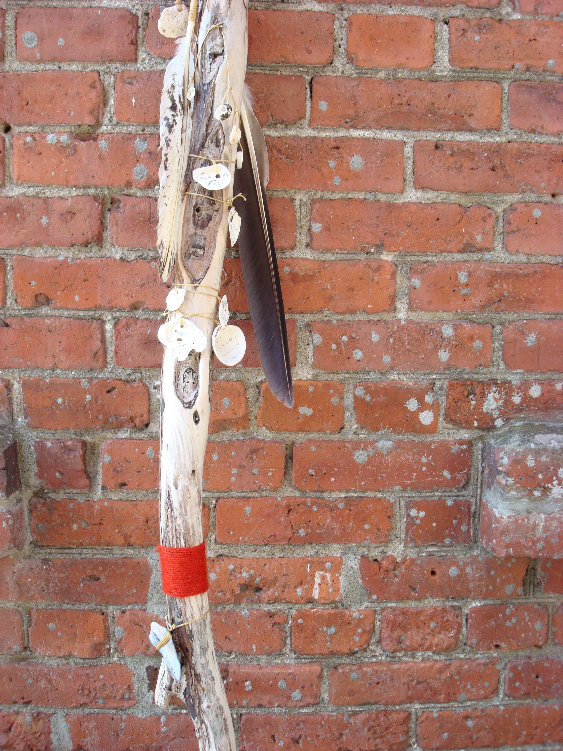
Story Stick Reflection
Brigid Skelton, BFA, teacher candidate
“The Story Stick Class: Learning and Teaching in an Indigenous World was a class unlike
any other I’ve ever attended at University. We learned by example and by experience
in a warm and accepting atmosphere, with no text books, no tests and
almost no questions. “
Steve

Slide 48
Challenges
Overcoming colonial history, relationships, habits of wardship
Overcoming distrust, hurt, anger, apathy, invisibility, control, loss
“We know best what is good for you”
Understanding diversity and complexity of Indigenous population
control

Slide 49
Challenges for revitalization
Western ideologies, epistemologies, practical and pedagogical factors
Racial hierarchies, socioeconomic domination, wards of the government, intellectual inferiority, primitive, lazy, marginalization,

Slide 50
Leadership and strength promotion
Assume leadership roles in communities and workplaces: Indigenizing institutional practice to meet needs of Indigenous communities,
Creating programs, policies and practice that are based on Indigenous worldview and decolonization
Decolonizing ones own views and practice

Slide 51
Program design
Indigenous
Decolonization
Knowledge
Worldview
Concepts, constructs
Values
Meaning
Practice
From stories, songs, ceremonies, languages, relationships
Beliefs about ourselves, families and communities
Valuation
Consciousness
Reconnecting to relationships, land, ancestors, families, communities,
Caring, sharing, humility

Slide 52
Program design
Western world
Features
Values
Understanding
Worldview
Critique
Modification
Integration
Drawing from both worlds
Goals for program
Habits of practice in the institution
Assessment
Standards
schedule
Learning environment
Utilizing all realms of knowledge

Slide 53
University Context
single discipline, competition between disciplines
based on a Eurowestern knowledge system as the only true way
protectionist, bounded, replication
standardization, uniformity
completion based, ‘cream rises to the top”, bell curve
business model rather than a service model

Slide 54
CONSIDERATIONS
ALIGNING TRADITIONAL KNOWLEDGE TO CURRENT TIMES,
RECONNECTING WITH TRADITIONAL KNOWLEDGE, UNDOING ENGLISH VERSIONS OF STORIES, SOCIAL STRUCTURES, FAMILY STRUCTURES, naming,

Slide 55
Tsukw ti7
Kukwstúm’ulhkal’ap nsnukw7a
Stúcumwi

