Slide 1

My Framework for Online EVERYTHING:
KEEP THINGS...
SIMPLE
EQUITABLE
ENGAGING
@bonstewart
Notes:
Mission statement: is it simple? Is it equitable? Is it engaging?

Slide 2
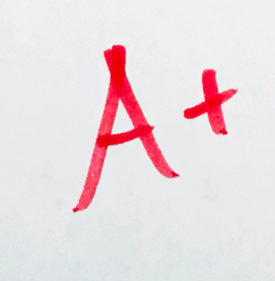
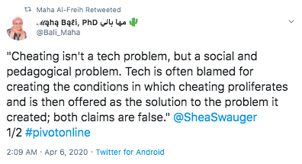
EQUITABLE:
assessment
Notes:
Equitable assessment: don’t make ANYTHING zero sum, be encouraging around dates and send reminders but recognize everything takes longer than you expect in a new environment: if you sat kids in a strange outdoor space to do math you wouldn’t anticipate they just knew how to navigate
Use the simplest tools available to communicate and receive assessment
Be tolerant of various formats, but also provide simple instructions for how you prefer to receive the assessment
Stick to one tool for assessment wherever you can - whether that is Edsby, D2L, Google Classroom etc.Don’t post some things as an assignment and others as an announcement, sometimes in the subject area and sometimes in the homeroom etc. Be consistent and predictable as much as possible.
Use the tools everyone has (theoretical) access to
How will you really evaluate or know what your students are able to do? As always, feedback is really important to your learners. In Ontario, use the time up until when final evaluations need to be done to practice with the tools you have available and plan what tools you will use for final evaluation.
Go back to the basics and focus on fundamentals

Slide 3
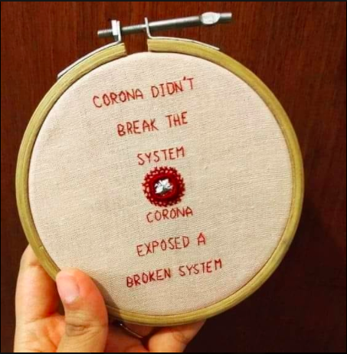
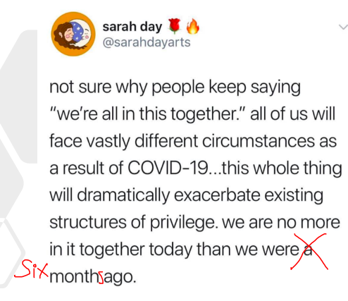

Slide 4
CRISIS:
At what level(s)?
Broader Society
Academia
Family
identity

Slide 5
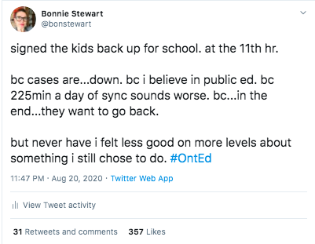
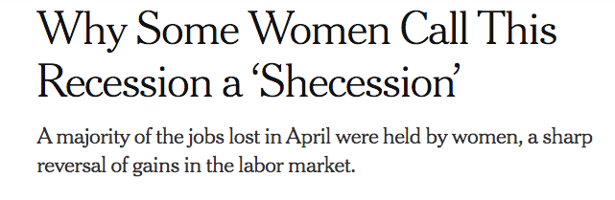
personal.
structural.

Slide 6
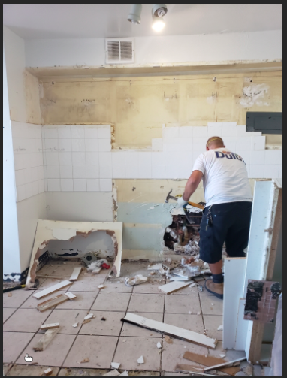
My student’s kitchen last month.
WHILE he presented to the class.
Some crises are short term…
But BIG.

Slide 7
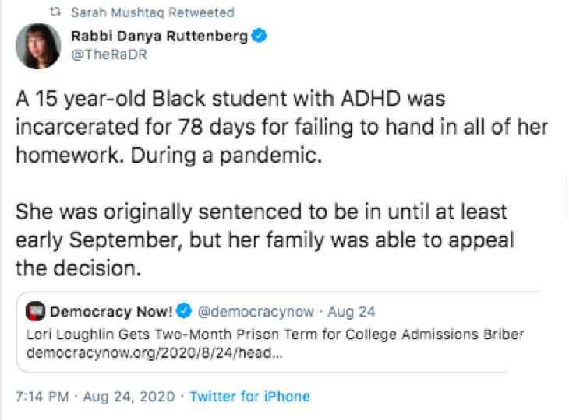
Some crises are
systemic.
Notes:
It’s easy to point to dramatic US disparities in how racialized or visible minority people are treated, but let us not pretend that the systemic racism, underlying bias and white supremacy are absent anywhere we work.

Slide 8
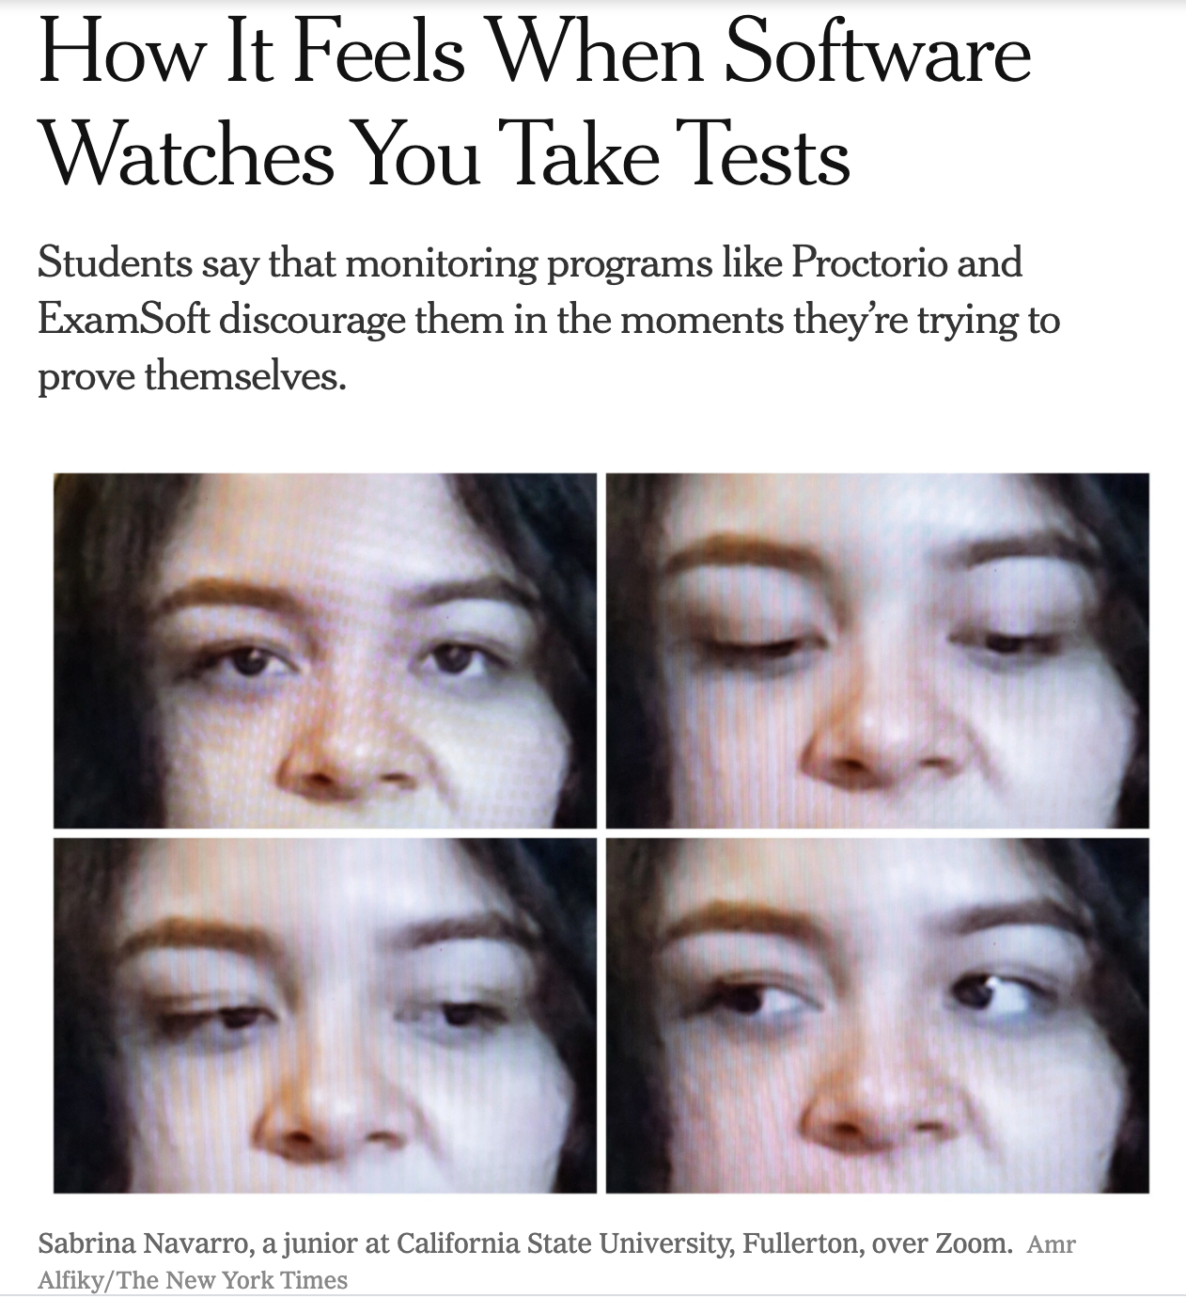
High-stakes testing
& proctoring only amplifies crises.

Slide 9
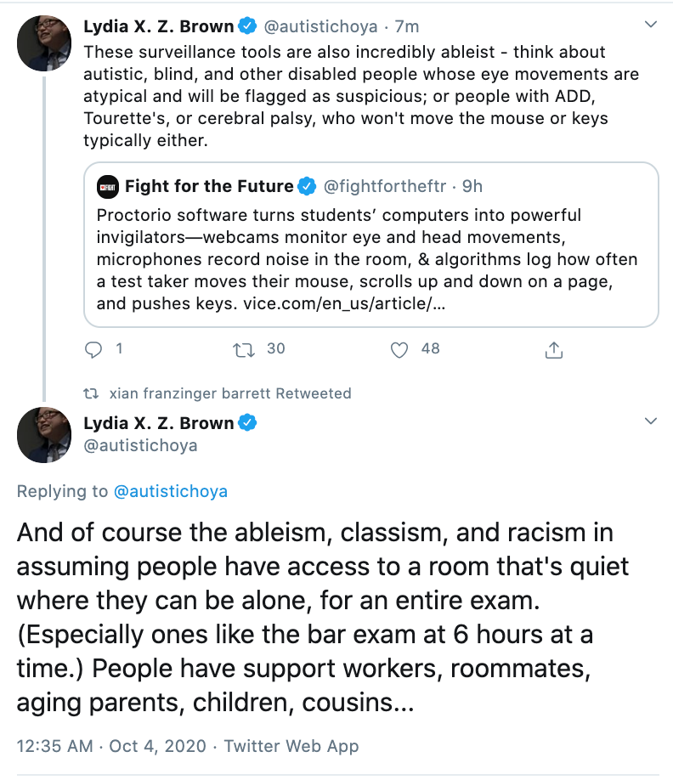
Proctoring surveillance tools limit accessibility.

Slide 10
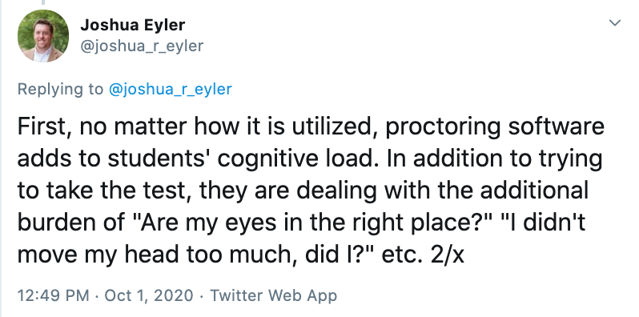
Proctoring surveillance tools limit focus.

Slide 11
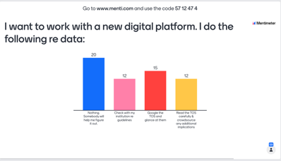

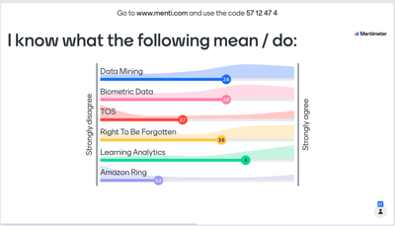
Alternatives to high-stakes testing

Slide 12
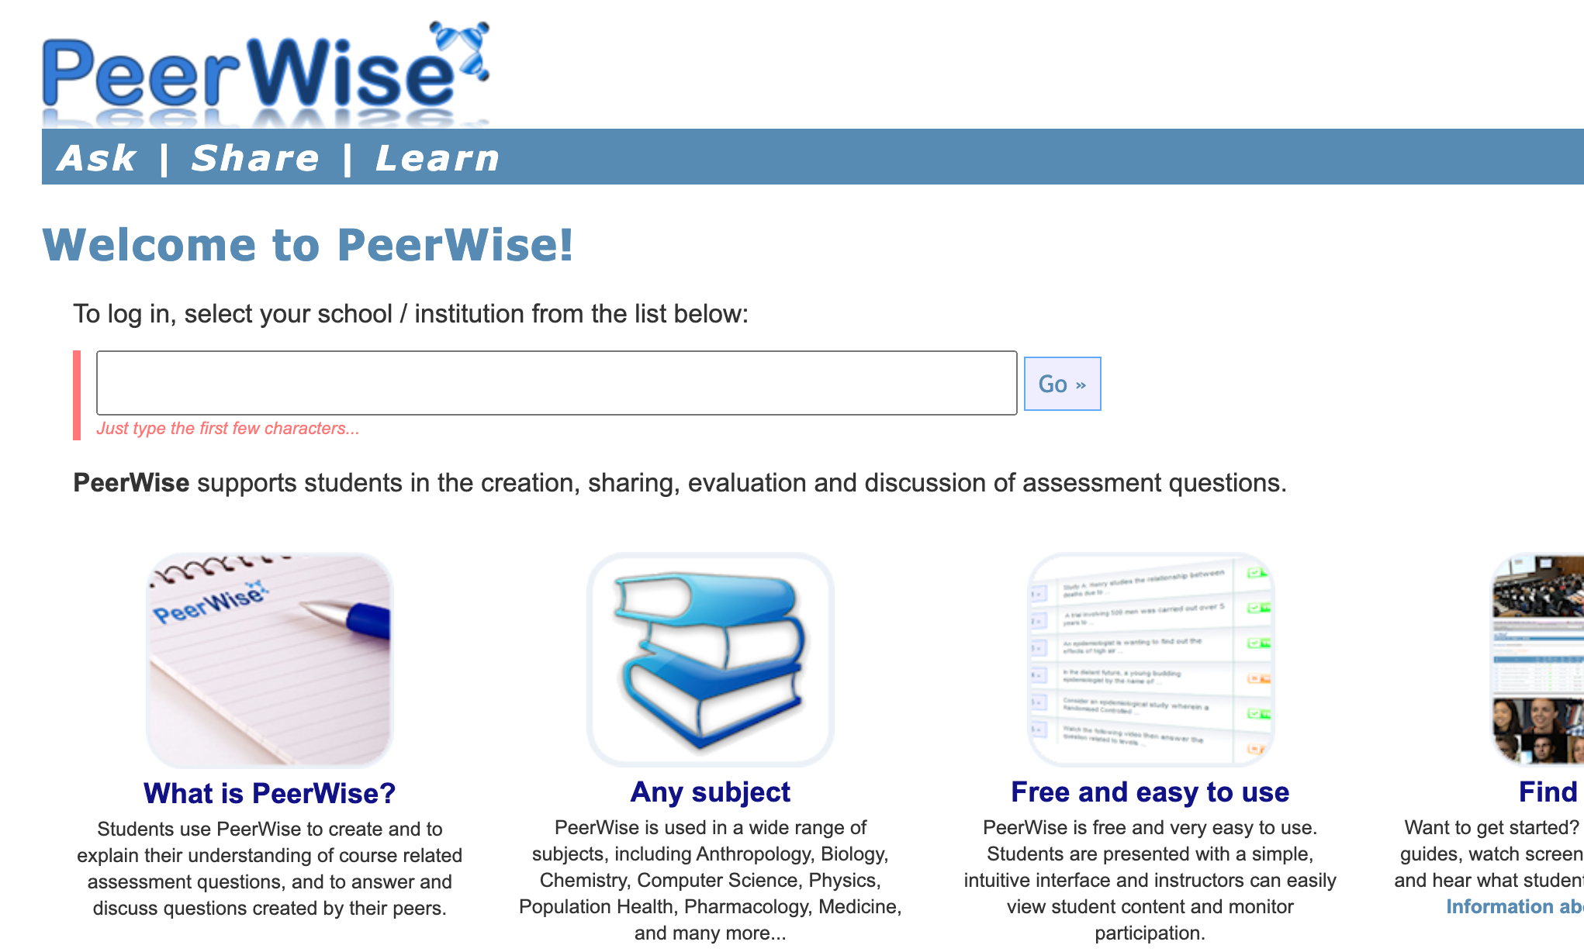
Alternative to high-stakes tests
Notes:
Peer Wise

Slide 13
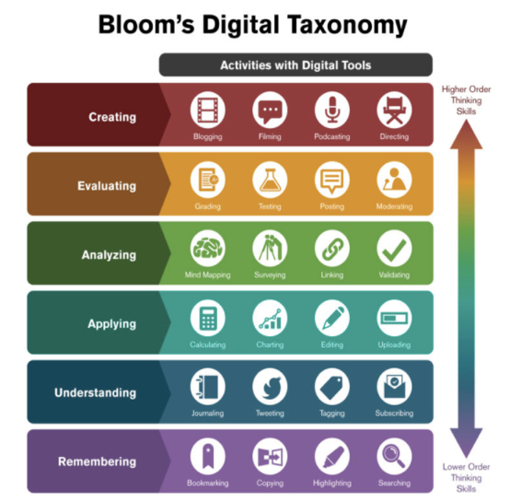
Work Within Knowledge
Abundance

Slide 14
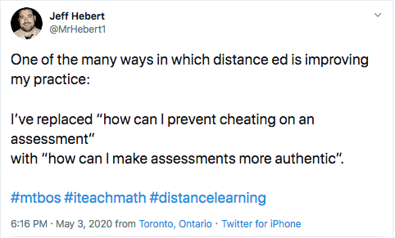
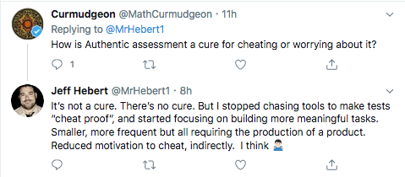
Aim for meaningful demonstrations of learning

